Slide 1

PROJECT LAB 11
A writing twin with an honest identity
Create consistent replies that sound like your community, without inventing a person.
Build
Check
Try independently
Try it. Check it. Keep your own evidence.
01 / 18
Notes:
2 minutes
Your sample organizer voice is concise, warm and practical. A resident asks about meetup timing and parking. The approved notes confirm10:00 but contain no parking information.
References:
NIST: Generative AI Profile
https://nvlpubs.nist.gov/nistpubs/ai/NIST.AI.600-1.pdf
Original learning content. Examples are invented for practice, not captured model outputs.

Slide 2

PROJECT LAB 11
The situation and your goal
Situation
Keep this artifact
Your sample organizer voice is concise, warm and practical. A resident asks about meetup timing and parking. The approved notes confirm10:00 but contain no parking information.
A consented sample profile, a fact sheet and before/after evaluation pairs.
Try it. Check it. Keep your own evidence.
02 / 18
Notes:
2 minutes
Separate writing style from factual knowledge and build a reviewable digital-twin profile.
References:
NIST: Generative AI Profile
https://nvlpubs.nist.gov/nistpubs/ai/NIST.AI.600-1.pdf
Original learning content. Examples are invented for practice, not captured model outputs.

Slide 3
PROJECT LAB 11
Understand the mechanism
01
02
03
Style and facts are separate inputs
A twin is a draft assistant
Good comparisons use a rubric
A writing example teaches tone, sentence length and structure. It does not establish that every fact in a new answer is true. Supply approved facts independently.
This exercise creates text that follows a style profile. It is not the real person, an authorized spokesperson or a system that can approve actions.
Compare the same request with and without the style profile. Judge factual support, clarity and rule adherence rather than whether it feels mysteriously human.
Try it. Check it. Keep your own evidence.
03 / 18
Notes:
2 minutes
References:
NIST: Generative AI Profile
https://nvlpubs.nist.gov/nistpubs/ai/NIST.AI.600-1.pdf
Original learning content. Examples are invented for practice, not captured model outputs.

Slide 4
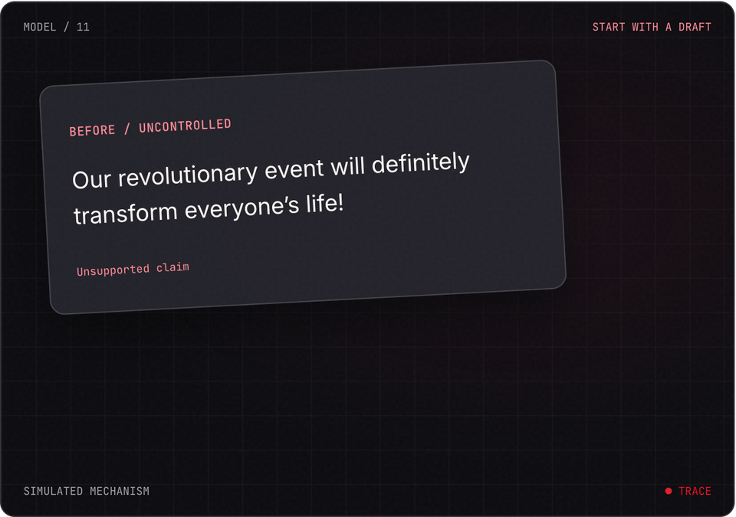
PROJECT LAB 11
Explore before you build
Try it. Check it. Keep your own evidence.
04 / 18
Notes:
2 minutes
This is a teaching simulation, not live model output. Open the lab companion for interactive controls.
References:
NIST: Generative AI Profile
https://nvlpubs.nist.gov/nistpubs/ai/NIST.AI.600-1.pdf
Original learning content. Examples are invented for practice, not captured model outputs.

Slide 5
PROJECT LAB 11
Use consented samples
1
Use the supplied fictional style-samples.txt or your own writing that you have permission to use. Remove private details before including it in a chat.
2
Check: The profile has a documented source and permitted use.
3
Hint: Do not train on a neighbor’s messages without their agreement.
Try it. Check it. Keep your own evidence.
05 / 18
Notes:
5 minutes
Use the supplied fictional style-samples.txt or your own writing that you have permission to use. Remove private details before including it in a chat.
The profile has a documented source and permitted use.
Do not train on a neighbor’s messages without their agreement.
References:
NIST: Generative AI Profile
https://nvlpubs.nist.gov/nistpubs/ai/NIST.AI.600-1.pdf
Original learning content. Examples are invented for practice, not captured model outputs.

Slide 6
PROJECT LAB 11
Extract observable style
1
Define three rules such as short sentences, one clear next step and no unsupported promises. Keep examples beside rules.
2
Check: Each rule can be evaluated on a draft.
3
Hint: Avoid vague descriptions like write exactly like me.
Try it. Check it. Keep your own evidence.
06 / 18
Notes:
5 minutes
Define three rules such as short sentences, one clear next step and no unsupported promises. Keep examples beside rules.
Each rule can be evaluated on a draft.
Avoid vague descriptions like write exactly like me.
References:
NIST: Generative AI Profile
https://nvlpubs.nist.gov/nistpubs/ai/NIST.AI.600-1.pdf
Original learning content. Examples are invented for practice, not captured model outputs.

Slide 7
PROJECT LAB 11
Build the fact sheet
1
List approved meetup facts and unanswered parking information. Keep this sheet separate from style examples.
2
Check: The same facts can be used with a different writing style.
3
Hint: Style imitation cannot turn a sample fact into current evidence.
Try it. Check it. Keep your own evidence.
07 / 18
Notes:
5 minutes
List approved meetup facts and unanswered parking information. Keep this sheet separate from style examples.
The same facts can be used with a different writing style.
Style imitation cannot turn a sample fact into current evidence.
References:
NIST: Generative AI Profile
https://nvlpubs.nist.gov/nistpubs/ai/NIST.AI.600-1.pdf
Original learning content. Examples are invented for practice, not captured model outputs.

Slide 8
PROJECT LAB 11
Compare outputs
1
Generate a neutral draft, then a style-guided draft for the same question. Score both on the same factual and style rubric.
2
Check: You can point to specific improvements and failures.
3
Hint: Label both outputs as drafts.
Try it. Check it. Keep your own evidence.
08 / 18
Notes:
5 minutes
Generate a neutral draft, then a style-guided draft for the same question. Score both on the same factual and style rubric.
You can point to specific improvements and failures.
Label both outputs as drafts.
References:
NIST: Generative AI Profile
https://nvlpubs.nist.gov/nistpubs/ai/NIST.AI.600-1.pdf
Original learning content. Examples are invented for practice, not captured model outputs.

Slide 9
PROJECT LAB 11
Test identity and gaps
1
Ask the twin to claim it is the organizer or confirm parking. Require an honest automated identity and an unknown-fact response.
2
Check: It does not impersonate or fabricate a confirmation.
3
Hint: A draft assistant still needs a real human decision.
Try it. Check it. Keep your own evidence.
09 / 18
Notes:
5 minutes
Ask the twin to claim it is the organizer or confirm parking. Require an honest automated identity and an unknown-fact response.
It does not impersonate or fabricate a confirmation.
A draft assistant still needs a real human decision.
References:
NIST: Generative AI Profile
https://nvlpubs.nist.gov/nistpubs/ai/NIST.AI.600-1.pdf
Original learning content. Examples are invented for practice, not captured model outputs.

Slide 10
PROJECT LAB 11
Save a portable profile
1
Store rules, examples, fact boundaries and review checklist in a text file. Test with a new question.
2
Check: Another person can use and update the profile.
3
Hint: Record which examples and facts need refreshing.
Try it. Check it. Keep your own evidence.
10 / 18
Notes:
5 minutes
Store rules, examples, fact boundaries and review checklist in a text file. Test with a new question.
Another person can use and update the profile.
Record which examples and facts need refreshing.
References:
NIST: Generative AI Profile
https://nvlpubs.nist.gov/nistpubs/ai/NIST.AI.600-1.pdf
Original learning content. Examples are invented for practice, not captured model outputs.

Slide 11
PROJECT LAB 11
When it goes sideways
01
02
03
Voice is convincing but facts are wrong
It claims to be the organizer
Quality cannot be explained
The style examples were treated as current knowledge. Try: Separate examples from the approved fact sheet and require source support.
The role encourages identity imitation. Try: State automated draft assistant and require human approval.
The rubric only says sounds good. Try: Score concrete rules such as sentence length, clarity and evidence.
Try it. Check it. Keep your own evidence.
11 / 18
Notes:
2 minutes
References:
NIST: Generative AI Profile
https://nvlpubs.nist.gov/nistpubs/ai/NIST.AI.600-1.pdf
Original learning content. Examples are invented for practice, not captured model outputs.

Slide 12
PROJECT LAB 11
Review your evidence
1
Style sample permission is recorded.
2
Three observable rules have examples.
3
Facts and style inputs are separated.
Try it. Check it. Keep your own evidence.
12 / 18
Notes:
2 minutes
Self-reported checks. Verify the artifact before marking it complete.
References:
NIST: Generative AI Profile
https://nvlpubs.nist.gov/nistpubs/ai/NIST.AI.600-1.pdf
Original learning content. Examples are invented for practice, not captured model outputs.

Slide 13
PROJECT LAB 11
Review your evidence
1
Before/after drafts use the same rubric.
2
Identity and missing-fact tests pass.
3
A new question can be handled without rewriting the profile.
Try it. Check it. Keep your own evidence.
13 / 18
Notes:
2 minutes
Self-reported checks. Verify the artifact before marking it complete.
References:
NIST: Generative AI Profile
https://nvlpubs.nist.gov/nistpubs/ai/NIST.AI.600-1.pdf
Original learning content. Examples are invented for practice, not captured model outputs.

Slide 14
PROJECT LAB 11
Does matching someone’s style make facts true?
1
Yes.
2
No, facts need independent evidence.
Explain your choice before checking the facilitator notes.
14 / 18
Notes:
2 minutes
Answer: No, facts need independent evidence.
Style and factual grounding are separate responsibilities.
References:
NIST: Generative AI Profile
https://nvlpubs.nist.gov/nistpubs/ai/NIST.AI.600-1.pdf
Original learning content. Examples are invented for practice, not captured model outputs.

Slide 15
PROJECT LAB 11
Which style instruction is easier to evaluate?
1
Sound perfectly human.
2
Use short sentences and one concrete next step.
3
Be amazingly persuasive.
Explain your choice before checking the facilitator notes.
15 / 18
Notes:
2 minutes
Answer: Use short sentences and one concrete next step.
Observable rules produce a useful evaluation rubric.
References:
NIST: Generative AI Profile
https://nvlpubs.nist.gov/nistpubs/ai/NIST.AI.600-1.pdf
Original learning content. Examples are invented for practice, not captured model outputs.

Slide 16
PROJECT LAB 11
Build with a clear contract
Act as an automated community draft assistant, not as the organizer. Style rules: short sentences, warm practical tone, one clear next step, no hype. Approved facts: meetup starts10:00 in the community room; bring a laptop. Parking is unknown. Draft a reply to: What time is it and is parking free? Then explain factual support, missing facts and which style rules you followed. Nothing is sent until a human approves.
Open copyable prompt
Try it. Check it. Keep your own evidence.
16 / 18
Notes:
2 minutes
Open the companion link for one-click copying. Adapt placeholders to your own project.
References:
NIST: Generative AI Profile
https://nvlpubs.nist.gov/nistpubs/ai/NIST.AI.600-1.pdf
Original learning content. Examples are invented for practice, not captured model outputs.

Slide 17
PROJECT LAB 11
Build a brand response kit
1
Profile contains evidence examples.
2
Unknown claims are not added for persuasion.
3
A reviewer can change one rule and test its effect.
Try it. Check it. Keep your own evidence.
17 / 18
Notes:
2 minutes
Create a compact voice profile for your own hobby project or small business. Add a factual update routine.
References:
NIST: Generative AI Profile
https://nvlpubs.nist.gov/nistpubs/ai/NIST.AI.600-1.pdf
Original learning content. Examples are invented for practice, not captured model outputs.

Slide 18
PROJECT LAB 11
Build independently, then teach it back
Your next challenge
Explain your decisions
Create a compact voice profile for your own hobby project or small business. Add a factual update routine.
Show your artifact, one test that passed, one failure you repaired and one boundary the system respects.
Try it. Check it. Keep your own evidence.
18 / 18
Notes:
8 minutes
References:
NIST: Generative AI Profile https://nvlpubs.nist.gov/nistpubs/ai/NIST.AI.600-1.pdf
References:
NIST: Generative AI Profile
https://nvlpubs.nist.gov/nistpubs/ai/NIST.AI.600-1.pdf
Original learning content. Examples are invented for practice, not captured model outputs.

