Slide 1

PROJECT LAB 09
A neighbourhood concierge bot
Make a bot answer the right question and show its limits clearly.
Build
Check
Try independently
Try it. Check it. Keep your own evidence.
01 / 18
Notes:
2 minutes
Residents ask your fictional bot about the next meetup. It should answer confirmed facts, show help and acknowledge unknown commands. It must not promise to be a human organizer.
References:
Telegram: Create a bot
https://core.telegram.org/bots/tutorial
n8n: Telegram webhook issues
https://docs.n8n.io/integrations/builtin/trigger-nodes/n8n-nodes-base.telegramtrigger/common-issues/
Original learning content. Examples are invented for practice, not captured model outputs.

Slide 2

PROJECT LAB 09
The situation and your goal
Situation
Keep this artifact
Residents ask your fictional bot about the next meetup. It should answer confirmed facts, show help and acknowledge unknown commands. It must not promise to be a human organizer.
A tested bot, a command table and a webhook troubleshooting note.
Try it. Check it. Keep your own evidence.
02 / 18
Notes:
2 minutes
Build a Telegram test bot with explicit commands, safe credentials and a fallback path.
References:
Telegram: Create a bot
https://core.telegram.org/bots/tutorial
n8n: Telegram webhook issues
https://docs.n8n.io/integrations/builtin/trigger-nodes/n8n-nodes-base.telegramtrigger/common-issues/
Original learning content. Examples are invented for practice, not captured model outputs.

Slide 3
PROJECT LAB 09
Understand the mechanism
01
02
03
A bot has an event boundary
One webhook needs a clear owner
Unknown commands need a route
A Telegram message creates an update. A trigger receives it, a workflow chooses a reply and the Telegram API sends the response. A text prompt alone is not a deployed bot.
Test and production configurations can compete for a bot webhook. Use a dedicated test bot and understand which workflow currently receives its updates.
A resident should get useful help when a command is absent or unsupported. Silence and invented answers both make a bot hard to trust.
Try it. Check it. Keep your own evidence.
03 / 18
Notes:
2 minutes
References:
Telegram: Create a bot
https://core.telegram.org/bots/tutorial
n8n: Telegram webhook issues
https://docs.n8n.io/integrations/builtin/trigger-nodes/n8n-nodes-base.telegramtrigger/common-issues/
Original learning content. Examples are invented for practice, not captured model outputs.

Slide 4
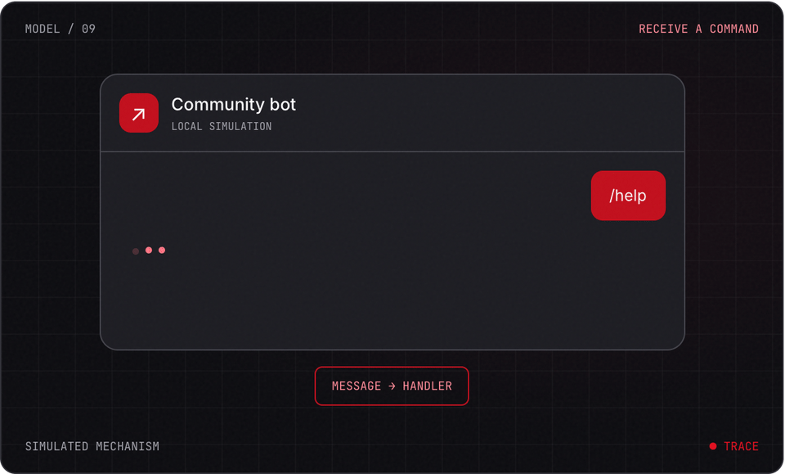
PROJECT LAB 09
Explore before you build
Try it. Check it. Keep your own evidence.
04 / 18
Notes:
2 minutes
This is a teaching simulation, not live model output. Open the lab companion for interactive controls.
References:
Telegram: Create a bot
https://core.telegram.org/bots/tutorial
n8n: Telegram webhook issues
https://docs.n8n.io/integrations/builtin/trigger-nodes/n8n-nodes-base.telegramtrigger/common-issues/
Original learning content. Examples are invented for practice, not captured model outputs.

Slide 5
PROJECT LAB 09
Create a test identity
1
Use BotFather to create a dedicated test bot. Store the token only in n8n credentials. Write an intro saying this is an automated demo.
2
Check: The bot has a clear identity and the token is not in slides or public files.
3
Hint: Use a separate test bot from an existing community bot.
Try it. Check it. Keep your own evidence.
05 / 18
Notes:
5 minutes
Use BotFather to create a dedicated test bot. Store the token only in n8n credentials. Write an intro saying this is an automated demo.
The bot has a clear identity and the token is not in slides or public files.
Use a separate test bot from an existing community bot.
References:
Telegram: Create a bot
https://core.telegram.org/bots/tutorial
n8n: Telegram webhook issues
https://docs.n8n.io/integrations/builtin/trigger-nodes/n8n-nodes-base.telegramtrigger/common-issues/
Original learning content. Examples are invented for practice, not captured model outputs.

Slide 6
PROJECT LAB 09
Prepare the command table
1
Define /start, /help and /next plus a fallback. The /next response uses only the approved Saturday10:00 community-room brief.
2
Check: Every supported command has one expected response.
3
Hint: Do not add unknown perks or live facts.
Try it. Check it. Keep your own evidence.
06 / 18
Notes:
5 minutes
Define /start, /help and /next plus a fallback. The /next response uses only the approved Saturday10:00 community-room brief.
Every supported command has one expected response.
Do not add unknown perks or live facts.
References:
Telegram: Create a bot
https://core.telegram.org/bots/tutorial
n8n: Telegram webhook issues
https://docs.n8n.io/integrations/builtin/trigger-nodes/n8n-nodes-base.telegramtrigger/common-issues/
Original learning content. Examples are invented for practice, not captured model outputs.

Slide 7
PROJECT LAB 09
Configure delivery
1
Add Telegram Trigger and connect credentials in n8n. Confirm that the webhook URL is public HTTPS from the trigger execution environment.
2
Check: Your own test message reaches the correct workflow.
3
Hint: A laptop localhost URL cannot be reached by Telegram without a suitable public webhook setup.
Try it. Check it. Keep your own evidence.
07 / 18
Notes:
5 minutes
Add Telegram Trigger and connect credentials in n8n. Confirm that the webhook URL is public HTTPS from the trigger execution environment.
Your own test message reaches the correct workflow.
A laptop localhost URL cannot be reached by Telegram without a suitable public webhook setup.
References:
Telegram: Create a bot
https://core.telegram.org/bots/tutorial
n8n: Telegram webhook issues
https://docs.n8n.io/integrations/builtin/trigger-nodes/n8n-nodes-base.telegramtrigger/common-issues/
Original learning content. Examples are invented for practice, not captured model outputs.

Slide 8
PROJECT LAB 09
Route and reply
1
Use explicit command conditions or a Switch node. Connect Telegram Send Message to the received chat ID.
2
Check: Each command replies only to the chat that sent the test request.
3
Hint: Do not hardcode a public group ID for this exercise.
Try it. Check it. Keep your own evidence.
08 / 18
Notes:
5 minutes
Use explicit command conditions or a Switch node. Connect Telegram Send Message to the received chat ID.
Each command replies only to the chat that sent the test request.
Do not hardcode a public group ID for this exercise.
References:
Telegram: Create a bot
https://core.telegram.org/bots/tutorial
n8n: Telegram webhook issues
https://docs.n8n.io/integrations/builtin/trigger-nodes/n8n-nodes-base.telegramtrigger/common-issues/
Original learning content. Examples are invented for practice, not captured model outputs.

Slide 9
PROJECT LAB 09
Test failure cases
1
Send unknown text, a missing command and /next. Check the execution log. If delivery stops, inspect test/production webhook ownership.
2
Check: Fallback and confirmed facts work; logs show input and chosen route.
3
Hint: Telegram bots cannot generally start a private chat with someone who has never contacted them.
Try it. Check it. Keep your own evidence.
09 / 18
Notes:
5 minutes
Send unknown text, a missing command and /next. Check the execution log. If delivery stops, inspect test/production webhook ownership.
Fallback and confirmed facts work; logs show input and chosen route.
Telegram bots cannot generally start a private chat with someone who has never contacted them.
References:
Telegram: Create a bot
https://core.telegram.org/bots/tutorial
n8n: Telegram webhook issues
https://docs.n8n.io/integrations/builtin/trigger-nodes/n8n-nodes-base.telegramtrigger/common-issues/
Original learning content. Examples are invented for practice, not captured model outputs.

Slide 10
PROJECT LAB 09
Hand off the bot
1
Document commands, token rotation location, active workflow, fallback and the approval step needed before adding it to a community group.
2
Check: Another organizer can troubleshoot one failed update.
3
Hint: Do not include the token in the handoff document.
Try it. Check it. Keep your own evidence.
10 / 18
Notes:
5 minutes
Document commands, token rotation location, active workflow, fallback and the approval step needed before adding it to a community group.
Another organizer can troubleshoot one failed update.
Do not include the token in the handoff document.
References:
Telegram: Create a bot
https://core.telegram.org/bots/tutorial
n8n: Telegram webhook issues
https://docs.n8n.io/integrations/builtin/trigger-nodes/n8n-nodes-base.telegramtrigger/common-issues/
Original learning content. Examples are invented for practice, not captured model outputs.

Slide 11
PROJECT LAB 09
When it goes sideways
01
02
03
The workflow receives no updates
Replies reach the wrong chat
The bot invents answers
Webhook URL is unreachable or another workflow owns it. Try: Check public HTTPS and use one active test/production owner.
A chat ID was hardcoded. Try: Map the chat ID from the current trigger update.
An unbounded AI step replaced a known command table. Try: Use explicit approved responses first and retain an unknown-answer path.
Try it. Check it. Keep your own evidence.
11 / 18
Notes:
2 minutes
References:
Telegram: Create a bot
https://core.telegram.org/bots/tutorial
n8n: Telegram webhook issues
https://docs.n8n.io/integrations/builtin/trigger-nodes/n8n-nodes-base.telegramtrigger/common-issues/
Original learning content. Examples are invented for practice, not captured model outputs.

Slide 12
PROJECT LAB 09
Review your evidence
1
Dedicated test bot and private credential storage are used.
2
Four command routes including fallback pass.
3
Reply chat ID comes from the incoming update.
Try it. Check it. Keep your own evidence.
12 / 18
Notes:
2 minutes
Self-reported checks. Verify the artifact before marking it complete.
References:
Telegram: Create a bot
https://core.telegram.org/bots/tutorial
n8n: Telegram webhook issues
https://docs.n8n.io/integrations/builtin/trigger-nodes/n8n-nodes-base.telegramtrigger/common-issues/
Original learning content. Examples are invented for practice, not captured model outputs.

Slide 13
PROJECT LAB 09
Review your evidence
1
Public webhook and ownership are documented.
2
Automated identity is clear.
3
No unauthorized group broadcast occurs.
Try it. Check it. Keep your own evidence.
13 / 18
Notes:
2 minutes
Self-reported checks. Verify the artifact before marking it complete.
References:
Telegram: Create a bot
https://core.telegram.org/bots/tutorial
n8n: Telegram webhook issues
https://docs.n8n.io/integrations/builtin/trigger-nodes/n8n-nodes-base.telegramtrigger/common-issues/
Original learning content. Examples are invented for practice, not captured model outputs.

Slide 14
PROJECT LAB 09
What identifies the reply destination?
1
A hardcoded group used for every request.
2
The chat ID on the incoming update.
3
The bot name alone.
Explain your choice before checking the facilitator notes.
14 / 18
Notes:
2 minutes
Answer: The chat ID on the incoming update.
The incoming update supplies the conversation context.
References:
Telegram: Create a bot
https://core.telegram.org/bots/tutorial
n8n: Telegram webhook issues
https://docs.n8n.io/integrations/builtin/trigger-nodes/n8n-nodes-base.telegramtrigger/common-issues/
Original learning content. Examples are invented for practice, not captured model outputs.

Slide 15
PROJECT LAB 09
Why use a dedicated test bot?
1
To avoid webhook conflicts with an existing live bot.
2
To skip credentials.
3
To send messages to anyone without consent.
Explain your choice before checking the facilitator notes.
15 / 18
Notes:
2 minutes
Answer: To avoid webhook conflicts with an existing live bot.
Testing can alter webhook ownership, so isolate the test identity.
References:
Telegram: Create a bot
https://core.telegram.org/bots/tutorial
n8n: Telegram webhook issues
https://docs.n8n.io/integrations/builtin/trigger-nodes/n8n-nodes-base.telegramtrigger/common-issues/
Original learning content. Examples are invented for practice, not captured model outputs.

Slide 16
PROJECT LAB 09
Build with a clear contract
Design a Telegram test-bot command table for /start, /help, /next and unknown text. Approved /next facts: Saturday10:00, community room, free entry. Identify the bot as an automated demo. Explain the n8n Telegram Trigger to routing to Send Message flow, mapping reply chat ID from the update, public HTTPS webhook requirements, test/production webhook conflicts and private token storage. Keep unsupported answers unknown.
Open copyable prompt
Try it. Check it. Keep your own evidence.
16 / 18
Notes:
2 minutes
Open the companion link for one-click copying. Adapt placeholders to your own project.
References:
Telegram: Create a bot
https://core.telegram.org/bots/tutorial
n8n: Telegram webhook issues
https://docs.n8n.io/integrations/builtin/trigger-nodes/n8n-nodes-base.telegramtrigger/common-issues/
Original learning content. Examples are invented for practice, not captured model outputs.

Slide 17
PROJECT LAB 09
Add a source-backed FAQ
1
Every FAQ has a source.
2
Missing answers are acknowledged.
3
An organizer can revoke or update a fact.
Try it. Check it. Keep your own evidence.
17 / 18
Notes:
2 minutes
Add two more approved FAQ entries and an unknown-answer route. Then compare a fixed table with an optional retrieval-based draft.
References:
Telegram: Create a bot
https://core.telegram.org/bots/tutorial
n8n: Telegram webhook issues
https://docs.n8n.io/integrations/builtin/trigger-nodes/n8n-nodes-base.telegramtrigger/common-issues/
Original learning content. Examples are invented for practice, not captured model outputs.

Slide 18
PROJECT LAB 09
Build independently, then teach it back
Your next challenge
Explain your decisions
Add two more approved FAQ entries and an unknown-answer route. Then compare a fixed table with an optional retrieval-based draft.
Show your artifact, one test that passed, one failure you repaired and one boundary the system respects.
Try it. Check it. Keep your own evidence.
18 / 18
Notes:
8 minutes
References:
Telegram: Create a bot https://core.telegram.org/bots/tutorial
n8n: Telegram webhook issues https://docs.n8n.io/integrations/builtin/trigger-nodes/n8n-nodes-base.telegramtrigger/common-issues/
References:
Telegram: Create a bot
https://core.telegram.org/bots/tutorial
n8n: Telegram webhook issues
https://docs.n8n.io/integrations/builtin/trigger-nodes/n8n-nodes-base.telegramtrigger/common-issues/
Original learning content. Examples are invented for practice, not captured model outputs.

