Slide 1

PROJECT LAB 07
BorrowBox dispatcher: a reliable automation
Route a messy lending request into the right queue without asking an AI.
Build
Check
Try independently
Try it. Check it. Keep your own evidence.
01 / 18
Notes:
2 minutes
A fictional lending desk receives normal requests, urgent requests and records without an item ID. Missing fields go to needs-details, urgent valid requests go to priority, and other valid requests go to normal.
References:
n8n: Edit Fields
https://docs.n8n.io/integrations/builtin/core-nodes/n8n-nodes-base.set/
n8n: If node
https://docs.n8n.io/integrations/builtin/core-nodes/n8n-nodes-base.if/
Original learning content. Examples are invented for practice, not captured model outputs.

Slide 2

PROJECT LAB 07
The situation and your goal
Situation
Keep this artifact
A fictional lending desk receives normal requests, urgent requests and records without an item ID. Missing fields go to needs-details, urgent valid requests go to priority, and other valid requests go to normal.
A workflow export and a six-case input/output table.
Try it. Check it. Keep your own evidence.
02 / 18
Notes:
2 minutes
Build an explicit n8n branching workflow and test every route.
References:
n8n: Edit Fields
https://docs.n8n.io/integrations/builtin/core-nodes/n8n-nodes-base.set/
n8n: If node
https://docs.n8n.io/integrations/builtin/core-nodes/n8n-nodes-base.if/
Original learning content. Examples are invented for practice, not captured model outputs.

Slide 3
PROJECT LAB 07
Understand the mechanism
01
02
03
Rules can be enough
Validate before routing
Retries need identities
A known routing policy is easier to inspect as explicit conditions. An LLM would introduce variability without adding a needed capability to this task.
Missing item IDs and strings pretending to be booleans can produce incorrect branches. Check shape and type before making the routing decision.
If a trigger repeats a request, a stable request ID lets you recognize duplication. Otherwise a reliable retry can accidentally create two jobs.
Try it. Check it. Keep your own evidence.
03 / 18
Notes:
2 minutes
References:
n8n: Edit Fields
https://docs.n8n.io/integrations/builtin/core-nodes/n8n-nodes-base.set/
n8n: If node
https://docs.n8n.io/integrations/builtin/core-nodes/n8n-nodes-base.if/
Original learning content. Examples are invented for practice, not captured model outputs.

Slide 4
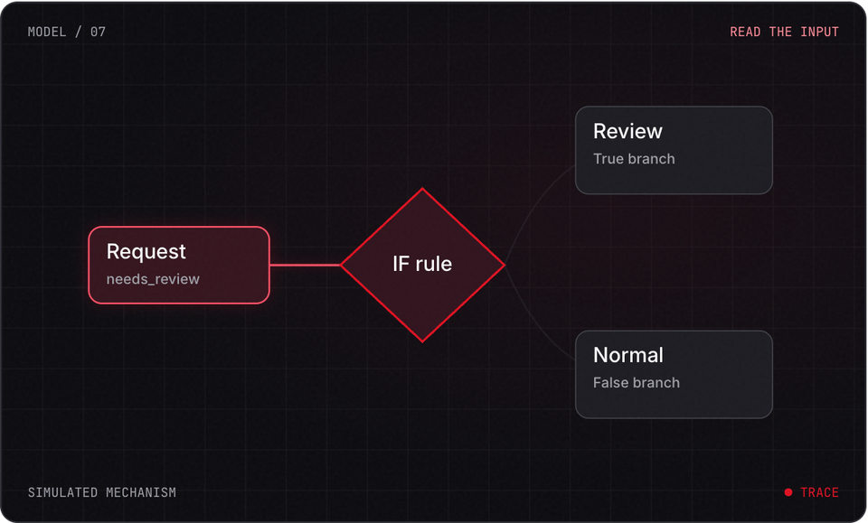
PROJECT LAB 07
Explore before you build
Try it. Check it. Keep your own evidence.
04 / 18
Notes:
2 minutes
This is a teaching simulation, not live model output. Open the lab companion for interactive controls.
References:
n8n: Edit Fields
https://docs.n8n.io/integrations/builtin/core-nodes/n8n-nodes-base.set/
n8n: If node
https://docs.n8n.io/integrations/builtin/core-nodes/n8n-nodes-base.if/
Original learning content. Examples are invented for practice, not captured model outputs.

Slide 5
PROJECT LAB 07
Write the routing table
1
Open dispatcher-cases.json. For each record predict needs-details, priority or normal. Define what counts as a valid item ID and urgent boolean.
2
Check: Each input has one expected outcome.
3
Hint: Missing details take precedence over urgency.
Try it. Check it. Keep your own evidence.
05 / 18
Notes:
5 minutes
Open dispatcher-cases.json. For each record predict needs-details, priority or normal. Define what counts as a valid item ID and urgent boolean.
Each input has one expected outcome.
Missing details take precedence over urgency.
References:
n8n: Edit Fields
https://docs.n8n.io/integrations/builtin/core-nodes/n8n-nodes-base.set/
n8n: If node
https://docs.n8n.io/integrations/builtin/core-nodes/n8n-nodes-base.if/
Original learning content. Examples are invented for practice, not captured model outputs.

Slide 6
PROJECT LAB 07
Build the trigger and fields
1
In your n8n test workflow use Manual Trigger and Edit Fields to supply the sample record. Keep requestId, itemId and urgent as typed fields.
2
Check: The output matches your input schema.
3
Hint: Do not use a real production webhook for this first test.
Try it. Check it. Keep your own evidence.
06 / 18
Notes:
5 minutes
In your n8n test workflow use Manual Trigger and Edit Fields to supply the sample record. Keep requestId, itemId and urgent as typed fields.
The output matches your input schema.
Do not use a real production webhook for this first test.
References:
n8n: Edit Fields
https://docs.n8n.io/integrations/builtin/core-nodes/n8n-nodes-base.set/
n8n: If node
https://docs.n8n.io/integrations/builtin/core-nodes/n8n-nodes-base.if/
Original learning content. Examples are invented for practice, not captured model outputs.

Slide 7
PROJECT LAB 07
Branch for missing details
1
Add an If node for missing or empty itemId. Route true to a named needs-details output.
2
Check: An urgent request with no item ID still asks for details.
3
Hint: This branch must happen before the urgency branch.
Try it. Check it. Keep your own evidence.
07 / 18
Notes:
5 minutes
Add an If node for missing or empty itemId. Route true to a named needs-details output.
An urgent request with no item ID still asks for details.
This branch must happen before the urgency branch.
References:
n8n: Edit Fields
https://docs.n8n.io/integrations/builtin/core-nodes/n8n-nodes-base.set/
n8n: If node
https://docs.n8n.io/integrations/builtin/core-nodes/n8n-nodes-base.if/
Original learning content. Examples are invented for practice, not captured model outputs.

Slide 8
PROJECT LAB 07
Branch for urgency
1
On valid requests add an If node that compares urgent as a boolean. Set the route field using Edit Fields on each branch.
2
Check: Valid urgent and normal requests reach their expected queues.
3
Hint: The string "false" is different from boolean false.
Try it. Check it. Keep your own evidence.
08 / 18
Notes:
5 minutes
On valid requests add an If node that compares urgent as a boolean. Set the route field using Edit Fields on each branch.
Valid urgent and normal requests reach their expected queues.
The string "false" is different from boolean false.
References:
n8n: Edit Fields
https://docs.n8n.io/integrations/builtin/core-nodes/n8n-nodes-base.set/
n8n: If node
https://docs.n8n.io/integrations/builtin/core-nodes/n8n-nodes-base.if/
Original learning content. Examples are invented for practice, not captured model outputs.

Slide 9
PROJECT LAB 07
Run every fixture
1
Execute each of the six cases. Record actual output and execution ID beside the expected route.
2
Check: All outputs match the table or have a documented type-validation error.
3
Hint: Do not declare success from a single green execution.
Try it. Check it. Keep your own evidence.
09 / 18
Notes:
5 minutes
Execute each of the six cases. Record actual output and execution ID beside the expected route.
All outputs match the table or have a documented type-validation error.
Do not declare success from a single green execution.
References:
n8n: Edit Fields
https://docs.n8n.io/integrations/builtin/core-nodes/n8n-nodes-base.set/
n8n: If node
https://docs.n8n.io/integrations/builtin/core-nodes/n8n-nodes-base.if/
Original learning content. Examples are invented for practice, not captured model outputs.

Slide 10
PROJECT LAB 07
Explain reliability
1
Export the workflow with no credentials. Describe how you would reject duplicate request IDs and handle an execution failure before enabling a real trigger.
2
Check: A partner can trace every branch.
3
Hint: Deduplication is an extension until an actual store is connected.
Try it. Check it. Keep your own evidence.
10 / 18
Notes:
5 minutes
Export the workflow with no credentials. Describe how you would reject duplicate request IDs and handle an execution failure before enabling a real trigger.
A partner can trace every branch.
Deduplication is an extension until an actual store is connected.
References:
n8n: Edit Fields
https://docs.n8n.io/integrations/builtin/core-nodes/n8n-nodes-base.set/
n8n: If node
https://docs.n8n.io/integrations/builtin/core-nodes/n8n-nodes-base.if/
Original learning content. Examples are invented for practice, not captured model outputs.

Slide 11
PROJECT LAB 07
When it goes sideways
01
02
03
Missing item goes to priority
The string false behaves strangely
Duplicate requests create duplicate work
Urgency ran before validation. Try: Reorder the workflow so missing details stop the normal routing path.
Input values were not typed consistently. Try: Validate booleans instead of relying on truthiness.
No stable request identity is checked. Try: Add a request-ID store before acting on real requests.
Try it. Check it. Keep your own evidence.
11 / 18
Notes:
2 minutes
References:
n8n: Edit Fields
https://docs.n8n.io/integrations/builtin/core-nodes/n8n-nodes-base.set/
n8n: If node
https://docs.n8n.io/integrations/builtin/core-nodes/n8n-nodes-base.if/
Original learning content. Examples are invented for practice, not captured model outputs.

Slide 12
PROJECT LAB 07
Review your evidence
1
All three routing outcomes are reachable.
2
Missing data takes precedence.
3
Boolean and string inputs are distinguished.
Try it. Check it. Keep your own evidence.
12 / 18
Notes:
2 minutes
Self-reported checks. Verify the artifact before marking it complete.
References:
n8n: Edit Fields
https://docs.n8n.io/integrations/builtin/core-nodes/n8n-nodes-base.set/
n8n: If node
https://docs.n8n.io/integrations/builtin/core-nodes/n8n-nodes-base.if/
Original learning content. Examples are invented for practice, not captured model outputs.

Slide 13
PROJECT LAB 07
Review your evidence
1
Six fixture outputs are recorded.
2
Export contains no credential secrets.
3
Duplicate-request handling is explained.
Try it. Check it. Keep your own evidence.
13 / 18
Notes:
2 minutes
Self-reported checks. Verify the artifact before marking it complete.
References:
n8n: Edit Fields
https://docs.n8n.io/integrations/builtin/core-nodes/n8n-nodes-base.set/
n8n: If node
https://docs.n8n.io/integrations/builtin/core-nodes/n8n-nodes-base.if/
Original learning content. Examples are invented for practice, not captured model outputs.

Slide 14
PROJECT LAB 07
Why use fixed conditions here?
1
The routing policy is known and deterministic.
2
AI always gives a better result.
3
Conditions remove the need for tests.
Explain your choice before checking the facilitator notes.
14 / 18
Notes:
2 minutes
Answer: The routing policy is known and deterministic.
Explicit rules are appropriate when the required policy is already clear.
References:
n8n: Edit Fields
https://docs.n8n.io/integrations/builtin/core-nodes/n8n-nodes-base.set/
n8n: If node
https://docs.n8n.io/integrations/builtin/core-nodes/n8n-nodes-base.if/
Original learning content. Examples are invented for practice, not captured model outputs.

Slide 15
PROJECT LAB 07
Which branch runs first?
1
Urgency.
2
Missing-details validation.
3
Random choice.
Explain your choice before checking the facilitator notes.
15 / 18
Notes:
2 minutes
Answer: Missing-details validation.
A request cannot be fulfilled without its required identity fields.
References:
n8n: Edit Fields
https://docs.n8n.io/integrations/builtin/core-nodes/n8n-nodes-base.set/
n8n: If node
https://docs.n8n.io/integrations/builtin/core-nodes/n8n-nodes-base.if/
Original learning content. Examples are invented for practice, not captured model outputs.

Slide 16
PROJECT LAB 07
Build with a clear contract
Design an n8n test workflow with Manual Trigger, Edit Fields and If nodes. Input fields: requestId string, itemId nonempty string, urgent boolean. Missing itemId routes to needs-details; valid urgent routes to priority; valid nonurgent routes to normal. Give a decision table including missing data, true, false, string "false" and repeated requestId. Explain where type validation and deduplication belong. Do not claim a dedup store exists until it is connected.
Open copyable prompt
Try it. Check it. Keep your own evidence.
16 / 18
Notes:
2 minutes
Open the companion link for one-click copying. Adapt placeholders to your own project.
References:
n8n: Edit Fields
https://docs.n8n.io/integrations/builtin/core-nodes/n8n-nodes-base.set/
n8n: If node
https://docs.n8n.io/integrations/builtin/core-nodes/n8n-nodes-base.if/
Original learning content. Examples are invented for practice, not captured model outputs.

Slide 17
PROJECT LAB 07
Add a quiet-hours policy
1
Start/end time boundaries are tested.
2
Missing details still take precedence.
3
The decision table and workflow agree.
Try it. Check it. Keep your own evidence.
17 / 18
Notes:
2 minutes
Introduce a time window: valid urgent requests during quiet hours should wait for review. Write boundary tests before editing the workflow.
References:
n8n: Edit Fields
https://docs.n8n.io/integrations/builtin/core-nodes/n8n-nodes-base.set/
n8n: If node
https://docs.n8n.io/integrations/builtin/core-nodes/n8n-nodes-base.if/
Original learning content. Examples are invented for practice, not captured model outputs.

Slide 18
PROJECT LAB 07
Build independently, then teach it back
Your next challenge
Explain your decisions
Introduce a time window: valid urgent requests during quiet hours should wait for review. Write boundary tests before editing the workflow.
Show your artifact, one test that passed, one failure you repaired and one boundary the system respects.
Try it. Check it. Keep your own evidence.
18 / 18
Notes:
8 minutes
References:
n8n: Edit Fields https://docs.n8n.io/integrations/builtin/core-nodes/n8n-nodes-base.set/
n8n: If node https://docs.n8n.io/integrations/builtin/core-nodes/n8n-nodes-base.if/
References:
n8n: Edit Fields
https://docs.n8n.io/integrations/builtin/core-nodes/n8n-nodes-base.set/
n8n: If node
https://docs.n8n.io/integrations/builtin/core-nodes/n8n-nodes-base.if/
Original learning content. Examples are invented for practice, not captured model outputs.

