Slide 1

PROJECT LAB 05
Pocket BorrowBox: put your app on a phone
Install your own useful webapp and understand exactly what works offline.
Build
Check
Try independently
Try it. Check it. Keep your own evidence.
01 / 18
Notes:
2 minutes
BorrowBox works in a browser. You want a phone home-screen entry with a proper name, icon and an honest offline experience.
References:
MDN: Making PWAs installable
https://developer.mozilla.org/en-US/docs/Web/Progressive_web_apps/Guides/Making_PWAs_installable
MDN: Service workers tutorial
https://developer.mozilla.org/en-US/docs/Web/Progressive_web_apps/Tutorials/CycleTracker/Service_workers
Original learning content. Examples are invented for practice, not captured model outputs.

Slide 2

PROJECT LAB 05
The situation and your goal
Situation
Keep this artifact
BorrowBox works in a browser. You want a phone home-screen entry with a proper name, icon and an honest offline experience.
A PWA folder, an install test and an offline capability table.
Try it. Check it. Keep your own evidence.
02 / 18
Notes:
2 minutes
Create and test an installable PWA with a deliberate caching policy.
References:
MDN: Making PWAs installable
https://developer.mozilla.org/en-US/docs/Web/Progressive_web_apps/Guides/Making_PWAs_installable
MDN: Service workers tutorial
https://developer.mozilla.org/en-US/docs/Web/Progressive_web_apps/Tutorials/CycleTracker/Service_workers
Original learning content. Examples are invented for practice, not captured model outputs.

Slide 3
PROJECT LAB 05
Understand the mechanism
01
02
03
A PWA is a web app
Cache is not data sync
Versions matter
A manifest supplies app identity and install information. Browser support and installation UX vary, so test the device rather than assuming every phone shows the same prompt.
A service worker can cache static app files. It does not automatically synchronize records, run a remote AI model offline or turn localStorage into cloud storage.
An old cached file can keep showing an outdated app. Name cache versions, remove obsolete caches in activation and test an update before sharing.
Try it. Check it. Keep your own evidence.
03 / 18
Notes:
2 minutes
References:
MDN: Making PWAs installable
https://developer.mozilla.org/en-US/docs/Web/Progressive_web_apps/Guides/Making_PWAs_installable
MDN: Service workers tutorial
https://developer.mozilla.org/en-US/docs/Web/Progressive_web_apps/Tutorials/CycleTracker/Service_workers
Original learning content. Examples are invented for practice, not captured model outputs.

Slide 4
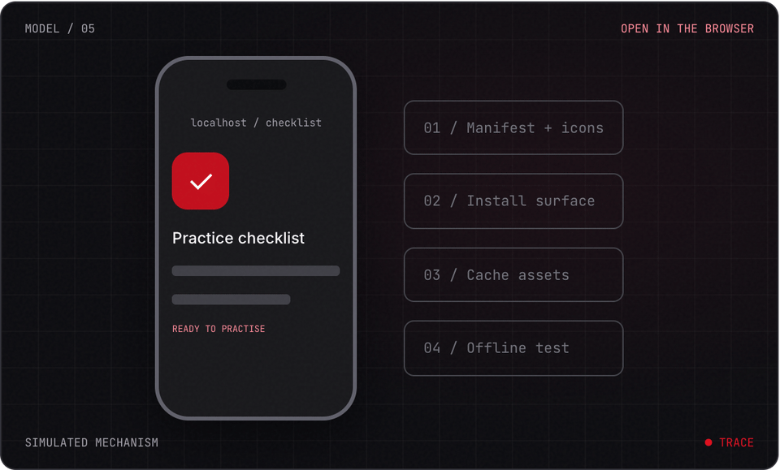
PROJECT LAB 05
Explore before you build
Try it. Check it. Keep your own evidence.
04 / 18
Notes:
2 minutes
This is a teaching simulation, not live model output. Open the lab companion for interactive controls.
References:
MDN: Making PWAs installable
https://developer.mozilla.org/en-US/docs/Web/Progressive_web_apps/Guides/Making_PWAs_installable
MDN: Service workers tutorial
https://developer.mozilla.org/en-US/docs/Web/Progressive_web_apps/Tutorials/CycleTracker/Service_workers
Original learning content. Examples are invented for practice, not captured model outputs.

Slide 5
PROJECT LAB 05
Prepare a real folder
1
Start from BorrowBox. Keep index.html, manifest.webmanifest, sw.js and the supplied 192/512 icons together.
2
Check: All relative paths resolve when served.
3
Hint: Local file URLs are not the reliable service-worker test environment.
Try it. Check it. Keep your own evidence.
05 / 18
Notes:
5 minutes
Start from BorrowBox. Keep index.html, manifest.webmanifest, sw.js and the supplied 192/512 icons together.
All relative paths resolve when served.
Local file URLs are not the reliable service-worker test environment.
References:
MDN: Making PWAs installable
https://developer.mozilla.org/en-US/docs/Web/Progressive_web_apps/Guides/Making_PWAs_installable
MDN: Service workers tutorial
https://developer.mozilla.org/en-US/docs/Web/Progressive_web_apps/Tutorials/CycleTracker/Service_workers
Original learning content. Examples are invented for practice, not captured model outputs.

Slide 6
PROJECT LAB 05
Define app identity
1
Set the name, short_name, start_url, display and icons in the manifest. Link it from HTML.
2
Check: Developer tools recognize the manifest and both icon sizes.
3
Hint: Use the supplied PNG icons; do not rename an SVG as a PNG.
Try it. Check it. Keep your own evidence.
06 / 18
Notes:
5 minutes
Set the name, short_name, start_url, display and icons in the manifest. Link it from HTML.
Developer tools recognize the manifest and both icon sizes.
Use the supplied PNG icons; do not rename an SVG as a PNG.
References:
MDN: Making PWAs installable
https://developer.mozilla.org/en-US/docs/Web/Progressive_web_apps/Guides/Making_PWAs_installable
MDN: Service workers tutorial
https://developer.mozilla.org/en-US/docs/Web/Progressive_web_apps/Tutorials/CycleTracker/Service_workers
Original learning content. Examples are invented for practice, not captured model outputs.

Slide 7
PROJECT LAB 05
Serve securely
1
Use localhost during development. Use HTTPS for phone deployment, then open the published URL on the phone.
2
Check: The service worker registers without a security error.
3
Hint: A localhost address on your laptop is not your phone localhost.
Try it. Check it. Keep your own evidence.
07 / 18
Notes:
5 minutes
Use localhost during development. Use HTTPS for phone deployment, then open the published URL on the phone.
The service worker registers without a security error.
A localhost address on your laptop is not your phone localhost.
References:
MDN: Making PWAs installable
https://developer.mozilla.org/en-US/docs/Web/Progressive_web_apps/Guides/Making_PWAs_installable
MDN: Service workers tutorial
https://developer.mozilla.org/en-US/docs/Web/Progressive_web_apps/Tutorials/CycleTracker/Service_workers
Original learning content. Examples are invented for practice, not captured model outputs.

Slide 8
PROJECT LAB 05
Choose offline behavior
1
Cache the local static shell and approved starter files. Explain that external links and remote model calls still require connectivity.
2
Check: The capability table separates cached UI from network functions.
3
Hint: Cache only known app resources, not arbitrary sensitive responses.
Try it. Check it. Keep your own evidence.
08 / 18
Notes:
5 minutes
Cache the local static shell and approved starter files. Explain that external links and remote model calls still require connectivity.
The capability table separates cached UI from network functions.
Cache only known app resources, not arbitrary sensitive responses.
References:
MDN: Making PWAs installable
https://developer.mozilla.org/en-US/docs/Web/Progressive_web_apps/Guides/Making_PWAs_installable
MDN: Service workers tutorial
https://developer.mozilla.org/en-US/docs/Web/Progressive_web_apps/Tutorials/CycleTracker/Service_workers
Original learning content. Examples are invented for practice, not captured model outputs.

Slide 9
PROJECT LAB 05
Test install and offline
1
Use the supported install or Add to Home Screen action. Disconnect network after a successful load, then reload and update a local item.
2
Check: The cached app opens and its local data still works where supported.
3
Hint: Offline success before a first load is not guaranteed.
Try it. Check it. Keep your own evidence.
09 / 18
Notes:
5 minutes
Use the supported install or Add to Home Screen action. Disconnect network after a successful load, then reload and update a local item.
The cached app opens and its local data still works where supported.
Offline success before a first load is not guaranteed.
References:
MDN: Making PWAs installable
https://developer.mozilla.org/en-US/docs/Web/Progressive_web_apps/Guides/Making_PWAs_installable
MDN: Service workers tutorial
https://developer.mozilla.org/en-US/docs/Web/Progressive_web_apps/Tutorials/CycleTracker/Service_workers
Original learning content. Examples are invented for practice, not captured model outputs.

Slide 10
PROJECT LAB 05
Ship an update
1
Change a visible version label, update the cache version and test the installed app refresh.
2
Check: The new version eventually appears and the old cache is removed.
3
Hint: Document the observed update behavior instead of promising instant replacement.
Try it. Check it. Keep your own evidence.
10 / 18
Notes:
5 minutes
Change a visible version label, update the cache version and test the installed app refresh.
The new version eventually appears and the old cache is removed.
Document the observed update behavior instead of promising instant replacement.
References:
MDN: Making PWAs installable
https://developer.mozilla.org/en-US/docs/Web/Progressive_web_apps/Guides/Making_PWAs_installable
MDN: Service workers tutorial
https://developer.mozilla.org/en-US/docs/Web/Progressive_web_apps/Tutorials/CycleTracker/Service_workers
Original learning content. Examples are invented for practice, not captured model outputs.

Slide 11
PROJECT LAB 05
When it goes sideways
01
02
03
No install button appears
Offline shows a broken page
The old app persists
The browser UX or installability requirements differ. Try: Inspect the manifest and security context, then follow the device-specific install flow.
Assets were never cached or their paths are wrong. Try: Inspect service-worker cache entries and test after a successful online load.
An obsolete cache is still serving files. Try: Use an explicit cache version and activation cleanup.
Try it. Check it. Keep your own evidence.
11 / 18
Notes:
2 minutes
References:
MDN: Making PWAs installable
https://developer.mozilla.org/en-US/docs/Web/Progressive_web_apps/Guides/Making_PWAs_installable
MDN: Service workers tutorial
https://developer.mozilla.org/en-US/docs/Web/Progressive_web_apps/Tutorials/CycleTracker/Service_workers
Original learning content. Examples are invented for practice, not captured model outputs.

Slide 12
PROJECT LAB 05
Review your evidence
1
Manifest and both icons validate.
2
App is served in an appropriate security context.
3
A real phone install test is documented.
Try it. Check it. Keep your own evidence.
12 / 18
Notes:
2 minutes
Self-reported checks. Verify the artifact before marking it complete.
References:
MDN: Making PWAs installable
https://developer.mozilla.org/en-US/docs/Web/Progressive_web_apps/Guides/Making_PWAs_installable
MDN: Service workers tutorial
https://developer.mozilla.org/en-US/docs/Web/Progressive_web_apps/Tutorials/CycleTracker/Service_workers
Original learning content. Examples are invented for practice, not captured model outputs.

Slide 13
PROJECT LAB 05
Review your evidence
1
Offline and online capabilities are distinguished.
2
An update/cache-version test passes.
Try it. Check it. Keep your own evidence.
13 / 18
Notes:
2 minutes
Self-reported checks. Verify the artifact before marking it complete.
References:
MDN: Making PWAs installable
https://developer.mozilla.org/en-US/docs/Web/Progressive_web_apps/Guides/Making_PWAs_installable
MDN: Service workers tutorial
https://developer.mozilla.org/en-US/docs/Web/Progressive_web_apps/Tutorials/CycleTracker/Service_workers
Original learning content. Examples are invented for practice, not captured model outputs.

Slide 14
PROJECT LAB 05
What does a service worker cache guarantee?
1
Every remote AI call works offline.
2
Only the resources and behavior your caching design actually supports.
3
Automatic cross-device sync.
Explain your choice before checking the facilitator notes.
14 / 18
Notes:
2 minutes
Answer: Only the resources and behavior your caching design actually supports.
Caching a shell does not make network services offline.
References:
MDN: Making PWAs installable
https://developer.mozilla.org/en-US/docs/Web/Progressive_web_apps/Guides/Making_PWAs_installable
MDN: Service workers tutorial
https://developer.mozilla.org/en-US/docs/Web/Progressive_web_apps/Tutorials/CycleTracker/Service_workers
Original learning content. Examples are invented for practice, not captured model outputs.

Slide 15
PROJECT LAB 05
Why test a cache update?
1
To prove a new version can replace the old files.
2
To increase the icon size.
3
To remove the need for HTTPS.
Explain your choice before checking the facilitator notes.
15 / 18
Notes:
2 minutes
Answer: To prove a new version can replace the old files.
Updates can be delayed by active service-worker and cache behavior.
References:
MDN: Making PWAs installable
https://developer.mozilla.org/en-US/docs/Web/Progressive_web_apps/Guides/Making_PWAs_installable
MDN: Service workers tutorial
https://developer.mozilla.org/en-US/docs/Web/Progressive_web_apps/Tutorials/CycleTracker/Service_workers
Original learning content. Examples are invented for practice, not captured model outputs.

Slide 16
PROJECT LAB 05
Build with a clear contract
Convert BorrowBox into a small PWA folder. Provide index.html, manifest.webmanifest and sw.js using existing 192/512 PNG icons. Explain localhost development and HTTPS phone testing. Cache the static shell with a named version and remove obsolete caches on activation. Include a manual install, offline and update checklist. Do not claim offline AI or cloud sync.
Open copyable prompt
Try it. Check it. Keep your own evidence.
16 / 18
Notes:
2 minutes
Open the companion link for one-click copying. Adapt placeholders to your own project.
References:
MDN: Making PWAs installable
https://developer.mozilla.org/en-US/docs/Web/Progressive_web_apps/Guides/Making_PWAs_installable
MDN: Service workers tutorial
https://developer.mozilla.org/en-US/docs/Web/Progressive_web_apps/Tutorials/CycleTracker/Service_workers
Original learning content. Examples are invented for practice, not captured model outputs.

Slide 17
PROJECT LAB 05
Install a field checklist
1
Local edits survive reload.
2
Network-only behavior is labeled.
3
A stale version can be identified.
Try it. Check it. Keep your own evidence.
17 / 18
Notes:
2 minutes
Adapt the PWA to a volunteer setup checklist and add a visible last-saved indicator.
References:
MDN: Making PWAs installable
https://developer.mozilla.org/en-US/docs/Web/Progressive_web_apps/Guides/Making_PWAs_installable
MDN: Service workers tutorial
https://developer.mozilla.org/en-US/docs/Web/Progressive_web_apps/Tutorials/CycleTracker/Service_workers
Original learning content. Examples are invented for practice, not captured model outputs.

Slide 18
PROJECT LAB 05
Build independently, then teach it back
Your next challenge
Explain your decisions
Adapt the PWA to a volunteer setup checklist and add a visible last-saved indicator.
Show your artifact, one test that passed, one failure you repaired and one boundary the system respects.
Try it. Check it. Keep your own evidence.
18 / 18
Notes:
8 minutes
References:
MDN: Making PWAs installable https://developer.mozilla.org/en-US/docs/Web/Progressive_web_apps/Guides/Making_PWAs_installable
MDN: Service workers tutorial https://developer.mozilla.org/en-US/docs/Web/Progressive_web_apps/Tutorials/CycleTracker/Service_workers
References:
MDN: Making PWAs installable
https://developer.mozilla.org/en-US/docs/Web/Progressive_web_apps/Guides/Making_PWAs_installable
MDN: Service workers tutorial
https://developer.mozilla.org/en-US/docs/Web/Progressive_web_apps/Tutorials/CycleTracker/Service_workers
Original learning content. Examples are invented for practice, not captured model outputs.

