Slide 1

PROJECT LAB 04
BorrowBox: turn a page into a working app
Track a borrowed drill, a book and a folding chair without losing the list on refresh.
Build
Check
Try independently
Try it. Check it. Keep your own evidence.
01 / 18
Notes:
2 minutes
Your community lends objects. A resident needs to add an item, change it from available to borrowed, filter the list and recover the same state after refresh.
References:
MDN: localStorage
https://developer.mozilla.org/en-US/docs/Web/API/Window/localStorage
MDN: Your first website
https://developer.mozilla.org/en-US/docs/Learn_web_development/Getting_started/Your_first_website
Original learning content. Examples are invented for practice, not captured model outputs.

Slide 2

PROJECT LAB 04
The situation and your goal
Situation
Keep this artifact
Your community lends objects. A resident needs to add an item, change it from available to borrowed, filter the list and recover the same state after refresh.
A local BorrowBox app with add, filter, status change and refresh tests.
Try it. Check it. Keep your own evidence.
02 / 18
Notes:
2 minutes
Build a browser lending tracker with explicit state, validation and local persistence.
References:
MDN: localStorage
https://developer.mozilla.org/en-US/docs/Web/API/Window/localStorage
MDN: Your first website
https://developer.mozilla.org/en-US/docs/Learn_web_development/Getting_started/Your_first_website
Original learning content. Examples are invented for practice, not captured model outputs.

Slide 3
PROJECT LAB 04
Understand the mechanism
01
02
03
State is the source of truth
Persistence is separate from display
Inputs are untrusted text
Keep records in an array with stable IDs. Render the screen from those records. Reading the current DOM as your only database makes changes difficult to reason about.
localStorage can save a JSON string for this browser origin. It does not create a shared community database or a cross-device backup.
Trim empty names, prevent duplicates according to your rule and render names using textContent. Treat an entered HTML tag as text, not executable markup.
Try it. Check it. Keep your own evidence.
03 / 18
Notes:
2 minutes
References:
MDN: localStorage
https://developer.mozilla.org/en-US/docs/Web/API/Window/localStorage
MDN: Your first website
https://developer.mozilla.org/en-US/docs/Learn_web_development/Getting_started/Your_first_website
Original learning content. Examples are invented for practice, not captured model outputs.

Slide 4
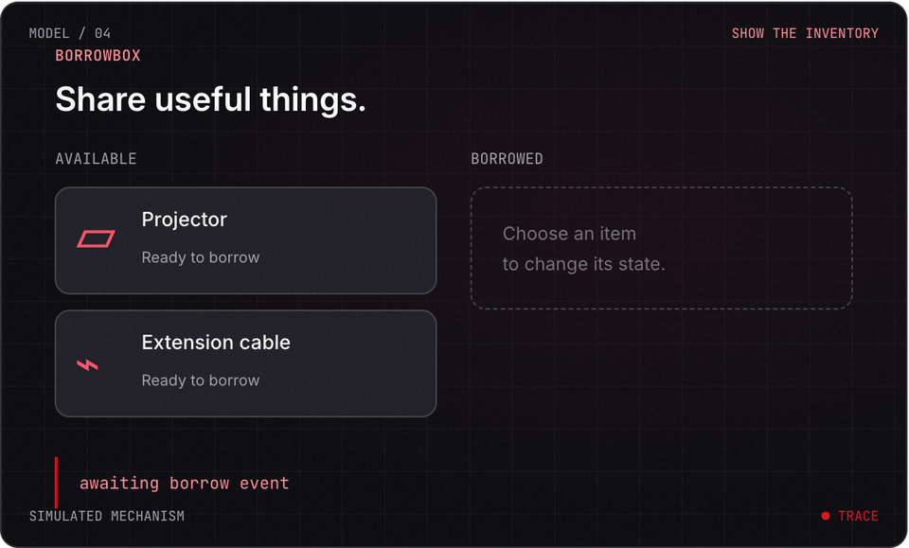
PROJECT LAB 04
Explore before you build
Try it. Check it. Keep your own evidence.
04 / 18
Notes:
2 minutes
This is a teaching simulation, not live model output. Open the lab companion for interactive controls.
References:
MDN: localStorage
https://developer.mozilla.org/en-US/docs/Web/API/Window/localStorage
MDN: Your first website
https://developer.mozilla.org/en-US/docs/Learn_web_development/Getting_started/Your_first_website
Original learning content. Examples are invented for practice, not captured model outputs.

Slide 5
PROJECT LAB 04
Define your record
1
Use borrowbox-items.json. Define id, name and status. Write the two allowed statuses and what happens for an empty name.
2
Check: You have an example valid record and invalid record.
3
Hint: Keep due dates as an extension until the basic state model works.
Try it. Check it. Keep your own evidence.
05 / 18
Notes:
5 minutes
Use borrowbox-items.json. Define id, name and status. Write the two allowed statuses and what happens for an empty name.
You have an example valid record and invalid record.
Keep due dates as an extension until the basic state model works.
References:
MDN: localStorage
https://developer.mozilla.org/en-US/docs/Web/API/Window/localStorage
MDN: Your first website
https://developer.mozilla.org/en-US/docs/Learn_web_development/Getting_started/Your_first_website
Original learning content. Examples are invented for practice, not captured model outputs.

Slide 6
PROJECT LAB 04
Build add and render
1
Create an input, add button and list. Add a new record to state, then rerender. Render user text safely.
2
Check: Adding a name shows one new item exactly once.
3
Hint: Use stable IDs for updates, not changing array positions.
Try it. Check it. Keep your own evidence.
06 / 18
Notes:
5 minutes
Create an input, add button and list. Add a new record to state, then rerender. Render user text safely.
Adding a name shows one new item exactly once.
Use stable IDs for updates, not changing array positions.
References:
MDN: localStorage
https://developer.mozilla.org/en-US/docs/Web/API/Window/localStorage
MDN: Your first website
https://developer.mozilla.org/en-US/docs/Learn_web_development/Getting_started/Your_first_website
Original learning content. Examples are invented for practice, not captured model outputs.

Slide 7
PROJECT LAB 04
Add transitions and filters
1
Implement available-to-borrowed and borrowed-to-available. Add an all, available and borrowed filter.
2
Check: Changing status updates the record and the filter results.
3
Hint: A filter should not delete records from state.
Try it. Check it. Keep your own evidence.
07 / 18
Notes:
5 minutes
Implement available-to-borrowed and borrowed-to-available. Add an all, available and borrowed filter.
Changing status updates the record and the filter results.
A filter should not delete records from state.
References:
MDN: localStorage
https://developer.mozilla.org/en-US/docs/Web/API/Window/localStorage
MDN: Your first website
https://developer.mozilla.org/en-US/docs/Learn_web_development/Getting_started/Your_first_website
Original learning content. Examples are invented for practice, not captured model outputs.

Slide 8
PROJECT LAB 04
Persist and restore
1
Serialize records into localStorage after changes. On load, parse inside try/catch and validate the shape before rendering.
2
Check: Refresh restores the same list on the same origin.
3
Hint: Serve on localhost for consistent tests. Private browsing or denied storage can fail.
Try it. Check it. Keep your own evidence.
08 / 18
Notes:
5 minutes
Serialize records into localStorage after changes. On load, parse inside try/catch and validate the shape before rendering.
Refresh restores the same list on the same origin.
Serve on localhost for consistent tests. Private browsing or denied storage can fail.
References:
MDN: localStorage
https://developer.mozilla.org/en-US/docs/Web/API/Window/localStorage
MDN: Your first website
https://developer.mozilla.org/en-US/docs/Learn_web_development/Getting_started/Your_first_website
Original learning content. Examples are invented for practice, not captured model outputs.

Slide 9
PROJECT LAB 04
Break the happy path
1
Try an empty name, duplicate name, very long name and a literal HTML tag. Put invalid JSON in the app storage key using developer tools.
2
Check: The app explains invalid input and recovers from damaged storage.
3
Hint: Do not clear unrelated localStorage keys.
Try it. Check it. Keep your own evidence.
09 / 18
Notes:
5 minutes
Try an empty name, duplicate name, very long name and a literal HTML tag. Put invalid JSON in the app storage key using developer tools.
The app explains invalid input and recovers from damaged storage.
Do not clear unrelated localStorage keys.
References:
MDN: localStorage
https://developer.mozilla.org/en-US/docs/Web/API/Window/localStorage
MDN: Your first website
https://developer.mozilla.org/en-US/docs/Learn_web_development/Getting_started/Your_first_website
Original learning content. Examples are invented for practice, not captured model outputs.

Slide 10
PROJECT LAB 04
Explain its boundary
1
Write a short handoff note: local device only, no account sync, how to export or reset your own records.
2
Check: Your partner understands why another phone sees a different list.
3
Hint: A real shared app needs a backend and access rules.
Try it. Check it. Keep your own evidence.
10 / 18
Notes:
5 minutes
Write a short handoff note: local device only, no account sync, how to export or reset your own records.
Your partner understands why another phone sees a different list.
A real shared app needs a backend and access rules.
References:
MDN: localStorage
https://developer.mozilla.org/en-US/docs/Web/API/Window/localStorage
MDN: Your first website
https://developer.mozilla.org/en-US/docs/Learn_web_development/Getting_started/Your_first_website
Original learning content. Examples are invented for practice, not captured model outputs.

Slide 11
PROJECT LAB 04
When it goes sideways
01
02
03
Refresh loses items
Filter destroys hidden records
Entered HTML changes the page
The app never writes state, or the origin changed. Try: Check the storage key, saved JSON and current page origin.
The filtered view replaced the original array. Try: Compute a visible subset and keep the complete state.
User input was inserted with innerHTML. Try: Render the item name with textContent.
Try it. Check it. Keep your own evidence.
11 / 18
Notes:
2 minutes
References:
MDN: localStorage
https://developer.mozilla.org/en-US/docs/Web/API/Window/localStorage
MDN: Your first website
https://developer.mozilla.org/en-US/docs/Learn_web_development/Getting_started/Your_first_website
Original learning content. Examples are invented for practice, not captured model outputs.

Slide 12
PROJECT LAB 04
Review your evidence
1
Add, status change and three filters work.
2
Stable IDs identify records.
3
Refresh restores valid data.
Try it. Check it. Keep your own evidence.
12 / 18
Notes:
2 minutes
Self-reported checks. Verify the artifact before marking it complete.
References:
MDN: localStorage
https://developer.mozilla.org/en-US/docs/Web/API/Window/localStorage
MDN: Your first website
https://developer.mozilla.org/en-US/docs/Learn_web_development/Getting_started/Your_first_website
Original learning content. Examples are invented for practice, not captured model outputs.

Slide 13
PROJECT LAB 04
Review your evidence
1
Invalid JSON and denied storage have a visible recovery path.
2
HTML-like input stays literal text.
3
Local-only data limits are documented.
Try it. Check it. Keep your own evidence.
13 / 18
Notes:
2 minutes
Self-reported checks. Verify the artifact before marking it complete.
References:
MDN: localStorage
https://developer.mozilla.org/en-US/docs/Web/API/Window/localStorage
MDN: Your first website
https://developer.mozilla.org/en-US/docs/Learn_web_development/Getting_started/Your_first_website
Original learning content. Examples are invented for practice, not captured model outputs.

Slide 14
PROJECT LAB 04
Why can a second phone see an empty list?
1
localStorage belongs to a browser origin and device.
2
The first phone is definitely broken.
3
The app secretly deleted the community database.
Explain your choice before checking the facilitator notes.
14 / 18
Notes:
2 minutes
Answer: localStorage belongs to a browser origin and device.
This local app does not have shared storage.
References:
MDN: localStorage
https://developer.mozilla.org/en-US/docs/Web/API/Window/localStorage
MDN: Your first website
https://developer.mozilla.org/en-US/docs/Learn_web_development/Getting_started/Your_first_website
Original learning content. Examples are invented for practice, not captured model outputs.

Slide 15
PROJECT LAB 04
How should item names be rendered?
1
Concatenate them into innerHTML.
2
Use textContent.
3
Evaluate them as JavaScript.
Explain your choice before checking the facilitator notes.
15 / 18
Notes:
2 minutes
Answer: Use textContent.
textContent treats the user input as text.
References:
MDN: localStorage
https://developer.mozilla.org/en-US/docs/Web/API/Window/localStorage
MDN: Your first website
https://developer.mozilla.org/en-US/docs/Learn_web_development/Getting_started/Your_first_website
Original learning content. Examples are invented for practice, not captured model outputs.

Slide 16
PROJECT LAB 04
Build with a clear contract
Build a single-file BorrowBox lending tracker. Each record has a stable id, name and status (available or borrowed). Add records, switch status and filter without deleting hidden records. Trim and reject empty names; show duplicate warnings. Persist JSON in a namespaced localStorage key, recover visibly from invalid JSON or storage denial, and render input with textContent. Explain the state transitions and give manual tests. This is a local-only demo, not a shared database.
Open copyable prompt
Try it. Check it. Keep your own evidence.
16 / 18
Notes:
2 minutes
Open the companion link for one-click copying. Adapt placeholders to your own project.
References:
MDN: localStorage
https://developer.mozilla.org/en-US/docs/Web/API/Window/localStorage
MDN: Your first website
https://developer.mozilla.org/en-US/docs/Learn_web_development/Getting_started/Your_first_website
Original learning content. Examples are invented for practice, not captured model outputs.

Slide 17
PROJECT LAB 04
Add a due-date view
1
Filter does not modify stored records.
2
Invalid dates are handled.
3
Exported records can be inspected as JSON.
Try it. Check it. Keep your own evidence.
17 / 18
Notes:
2 minutes
Introduce a due date and an overdue filter. Test the boundary at midnight and with a missing date.
References:
MDN: localStorage
https://developer.mozilla.org/en-US/docs/Web/API/Window/localStorage
MDN: Your first website
https://developer.mozilla.org/en-US/docs/Learn_web_development/Getting_started/Your_first_website
Original learning content. Examples are invented for practice, not captured model outputs.

Slide 18
PROJECT LAB 04
Build independently, then teach it back
Your next challenge
Explain your decisions
Introduce a due date and an overdue filter. Test the boundary at midnight and with a missing date.
Show your artifact, one test that passed, one failure you repaired and one boundary the system respects.
Try it. Check it. Keep your own evidence.
18 / 18
Notes:
8 minutes
References:
MDN: localStorage https://developer.mozilla.org/en-US/docs/Web/API/Window/localStorage
MDN: Your first website https://developer.mozilla.org/en-US/docs/Learn_web_development/Getting_started/Your_first_website
References:
MDN: localStorage
https://developer.mozilla.org/en-US/docs/Web/API/Window/localStorage
MDN: Your first website
https://developer.mozilla.org/en-US/docs/Learn_web_development/Getting_started/Your_first_website
Original learning content. Examples are invented for practice, not captured model outputs.

