Slide 1

PROJECT LAB 03
Neighbourhood Swap: your first useful website
Build a small site someone could use to find a repair session or swap event.
Build
Check
Try independently
Try it. Check it. Keep your own evidence.
01 / 18
Notes:
2 minutes
The fictional neighbourhood has three events. Residents need to see what, when and where, then use a clear contact link. You will build a real browser page from an approved data sheet.
References:
MDN: Your first website
https://developer.mozilla.org/en-US/docs/Learn_web_development/Getting_started/Your_first_website
Original learning content. Examples are invented for practice, not captured model outputs.

Slide 2

PROJECT LAB 03
The situation and your goal
Situation
Keep this artifact
The fictional neighbourhood has three events. Residents need to see what, when and where, then use a clear contact link. You will build a real browser page from an approved data sheet.
A three-event website, a written brief and a browser test checklist.
Try it. Check it. Keep your own evidence.
02 / 18
Notes:
2 minutes
Create a responsive, accessible event page and explain its HTML structure.
References:
MDN: Your first website
https://developer.mozilla.org/en-US/docs/Learn_web_development/Getting_started/Your_first_website
Original learning content. Examples are invented for practice, not captured model outputs.

Slide 3
PROJECT LAB 03
Understand the mechanism
01
02
03
HTML carries meaning
CSS controls presentation
A website is an artifact
Headings, lists, navigation and buttons tell browsers and assistive tools what content does. A visual div is not automatically an accessible control.
Spacing and responsive rules should adapt the same content to different screens. Content should remain readable when the viewport changes or text is enlarged.
A prompt is a request for a file. The deliverable is the saved code that opens in a browser and survives your tests, not a screenshot of a chat answer.
Try it. Check it. Keep your own evidence.
03 / 18
Notes:
2 minutes
References:
MDN: Your first website
https://developer.mozilla.org/en-US/docs/Learn_web_development/Getting_started/Your_first_website
Original learning content. Examples are invented for practice, not captured model outputs.

Slide 4
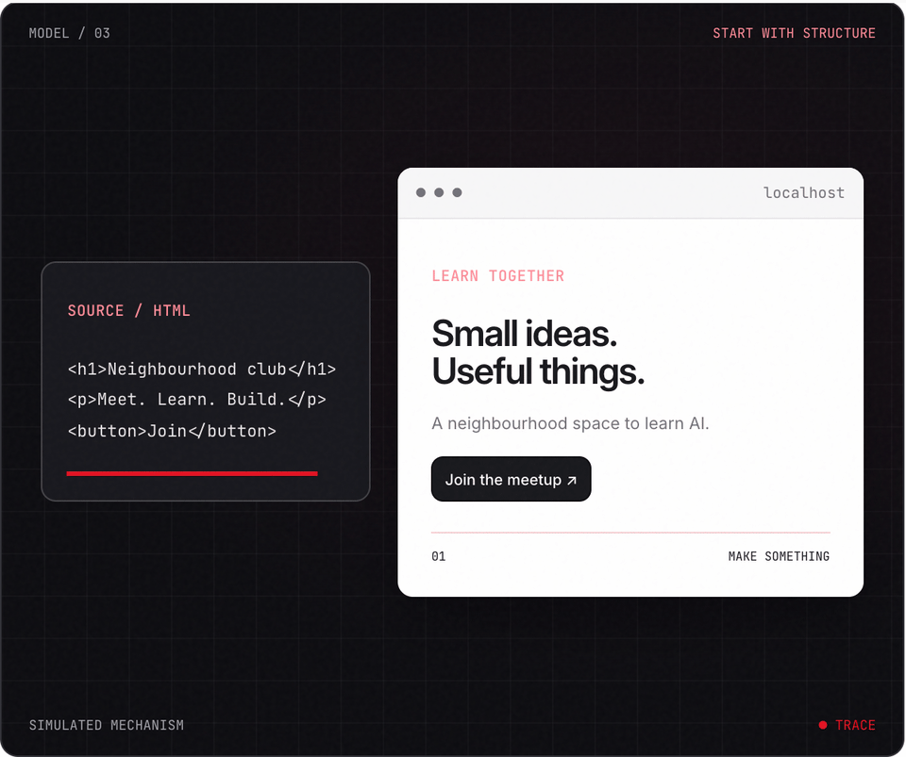
PROJECT LAB 03
Explore before you build
Try it. Check it. Keep your own evidence.
04 / 18
Notes:
2 minutes
This is a teaching simulation, not live model output. Open the lab companion for interactive controls.
References:
MDN: Your first website
https://developer.mozilla.org/en-US/docs/Learn_web_development/Getting_started/Your_first_website
Original learning content. Examples are invented for practice, not captured model outputs.

Slide 5
PROJECT LAB 03
Define the visitor job
1
Read swap-events.csv and choose one visitor question: which event can I attend this weekend? Write the required information and one primary action.
2
Check: Your brief names the visitor and an observable success action.
3
Hint: Use only the fictional supplied events.
Try it. Check it. Keep your own evidence.
05 / 18
Notes:
5 minutes
Read swap-events.csv and choose one visitor question: which event can I attend this weekend? Write the required information and one primary action.
Your brief names the visitor and an observable success action.
Use only the fictional supplied events.
References:
MDN: Your first website
https://developer.mozilla.org/en-US/docs/Learn_web_development/Getting_started/Your_first_website
Original learning content. Examples are invented for practice, not captured model outputs.

Slide 6
PROJECT LAB 03
Build the semantic page
1
Ask for one index.html with header, main, three event cards and footer. Save the code as UTF-8 and open it in a browser.
2
Check: All three records appear without invented details.
3
Hint: Check that the file extension is .html rather than .html.txt.
Try it. Check it. Keep your own evidence.
06 / 18
Notes:
5 minutes
Ask for one index.html with header, main, three event cards and footer. Save the code as UTF-8 and open it in a browser.
All three records appear without invented details.
Check that the file extension is .html rather than .html.txt.
References:
MDN: Your first website
https://developer.mozilla.org/en-US/docs/Learn_web_development/Getting_started/Your_first_website
Original learning content. Examples are invented for practice, not captured model outputs.

Slide 7
PROJECT LAB 03
Inspect the code
1
Find the h1, event headings, links and media query. Explain which section contains content and which contains styling.
2
Check: You can edit one event title without asking AI.
3
Hint: Use browser developer tools to inspect the rendered element.
Try it. Check it. Keep your own evidence.
07 / 18
Notes:
5 minutes
Find the h1, event headings, links and media query. Explain which section contains content and which contains styling.
You can edit one event title without asking AI.
Use browser developer tools to inspect the rendered element.
References:
MDN: Your first website
https://developer.mozilla.org/en-US/docs/Learn_web_development/Getting_started/Your_first_website
Original learning content. Examples are invented for practice, not captured model outputs.

Slide 8
PROJECT LAB 03
Improve the small screen
1
Use a single-column layout on narrow screens, visible focus styles and comfortable tap targets. Test at 320px and 390px.
2
Check: No horizontal overflow or clipped event title appears.
3
Hint: Do not hide overflow to conceal content that is too wide.
Try it. Check it. Keep your own evidence.
08 / 18
Notes:
5 minutes
Use a single-column layout on narrow screens, visible focus styles and comfortable tap targets. Test at 320px and 390px.
No horizontal overflow or clipped event title appears.
Do not hide overflow to conceal content that is too wide.
References:
MDN: Your first website
https://developer.mozilla.org/en-US/docs/Learn_web_development/Getting_started/Your_first_website
Original learning content. Examples are invented for practice, not captured model outputs.

Slide 9
PROJECT LAB 03
Test real actions
1
Use keyboard Tab to reach the contact link, check its destination and test the page with a long event name.
2
Check: The action works and focus remains visible.
3
Hint: A button with no behavior is not a working signup.
Try it. Check it. Keep your own evidence.
09 / 18
Notes:
5 minutes
Use keyboard Tab to reach the contact link, check its destination and test the page with a long event name.
The action works and focus remains visible.
A button with no behavior is not a working signup.
References:
MDN: Your first website
https://developer.mozilla.org/en-US/docs/Learn_web_development/Getting_started/Your_first_website
Original learning content. Examples are invented for practice, not captured model outputs.

Slide 10
PROJECT LAB 03
Document and hand off
1
Save a screenshot, the source file and a short note about what the page does and does not do.
2
Check: A partner can open the file and identify the primary action.
3
Hint: This first version has no backend or real booking system.
Try it. Check it. Keep your own evidence.
10 / 18
Notes:
5 minutes
Save a screenshot, the source file and a short note about what the page does and does not do.
A partner can open the file and identify the primary action.
This first version has no backend or real booking system.
References:
MDN: Your first website
https://developer.mozilla.org/en-US/docs/Learn_web_development/Getting_started/Your_first_website
Original learning content. Examples are invented for practice, not captured model outputs.

Slide 11
PROJECT LAB 03
When it goes sideways
01
02
03
The browser shows code as text
It looks good but the link does nothing
Mobile needs sideways scrolling
The file is saved with the wrong extension or contains markdown fences. Try: Save only the HTML content as index.html.
The generated page uses a placeholder destination. Try: Replace the placeholder with a real approved contact link or clearly label the demo.
A fixed-width element exceeds the viewport. Try: Use responsive widths and inspect the actual overflowing element.
Try it. Check it. Keep your own evidence.
11 / 18
Notes:
2 minutes
References:
MDN: Your first website
https://developer.mozilla.org/en-US/docs/Learn_web_development/Getting_started/Your_first_website
Original learning content. Examples are invented for practice, not captured model outputs.

Slide 12
PROJECT LAB 03
Review your evidence
1
Three approved events are displayed accurately.
2
Semantic headings and a main region are present.
3
Keyboard focus and contact link work.
Try it. Check it. Keep your own evidence.
12 / 18
Notes:
2 minutes
Self-reported checks. Verify the artifact before marking it complete.
References:
MDN: Your first website
https://developer.mozilla.org/en-US/docs/Learn_web_development/Getting_started/Your_first_website
Original learning content. Examples are invented for practice, not captured model outputs.

Slide 13
PROJECT LAB 03
Review your evidence
1
320px and 390px layouts stay readable.
2
You can change content directly in the source.
Try it. Check it. Keep your own evidence.
13 / 18
Notes:
2 minutes
Self-reported checks. Verify the artifact before marking it complete.
References:
MDN: Your first website
https://developer.mozilla.org/en-US/docs/Learn_web_development/Getting_started/Your_first_website
Original learning content. Examples are invented for practice, not captured model outputs.

Slide 14
PROJECT LAB 03
What is the real deliverable?
1
A screenshot of an AI answer.
2
The saved page and evidence that it works.
3
A longer prompt.
Explain your choice before checking the facilitator notes.
14 / 18
Notes:
2 minutes
Answer: The saved page and evidence that it works.
The website must exist as a working file, not just a description.
References:
MDN: Your first website
https://developer.mozilla.org/en-US/docs/Learn_web_development/Getting_started/Your_first_website
Original learning content. Examples are invented for practice, not captured model outputs.

Slide 15
PROJECT LAB 03
Which change belongs mainly to CSS?
1
Event date.
2
Meaning of the page heading.
3
Responsive spacing between cards.
Explain your choice before checking the facilitator notes.
15 / 18
Notes:
2 minutes
Answer: Responsive spacing between cards.
CSS changes presentation; the event facts and semantic structure belong in HTML.
References:
MDN: Your first website
https://developer.mozilla.org/en-US/docs/Learn_web_development/Getting_started/Your_first_website
Original learning content. Examples are invented for practice, not captured model outputs.

Slide 16
PROJECT LAB 03
Build with a clear contract
Build a single-file responsive Neighbourhood Swap website from this fictional dataset: Repair Cafe, Saturday 10:00, community room; Book Swap, Saturday 12:00, reading corner; Seed Exchange, Sunday 11:00, covered courtyard. Use semantic HTML, clear event cards, keyboard-visible focus and a narrow-screen single-column layout. No fake signup backend. Explain where I edit content and how I test the contact action.
Open copyable prompt
Try it. Check it. Keep your own evidence.
16 / 18
Notes:
2 minutes
Open the companion link for one-click copying. Adapt placeholders to your own project.
References:
MDN: Your first website
https://developer.mozilla.org/en-US/docs/Learn_web_development/Getting_started/Your_first_website
Original learning content. Examples are invented for practice, not captured model outputs.

Slide 17
PROJECT LAB 03
Create a repair-cafe microsite
1
All new facts come from your approved brief.
2
FAQ answers unknown questions honestly.
3
A partner completes the primary action.
Try it. Check it. Keep your own evidence.
17 / 18
Notes:
2 minutes
Change the visitor job to finding a repair session. Add a FAQ and one accessibility improvement without copying the original prompt.
References:
MDN: Your first website
https://developer.mozilla.org/en-US/docs/Learn_web_development/Getting_started/Your_first_website
Original learning content. Examples are invented for practice, not captured model outputs.

Slide 18
PROJECT LAB 03
Build independently, then teach it back
Your next challenge
Explain your decisions
Change the visitor job to finding a repair session. Add a FAQ and one accessibility improvement without copying the original prompt.
Show your artifact, one test that passed, one failure you repaired and one boundary the system respects.
Try it. Check it. Keep your own evidence.
18 / 18
Notes:
8 minutes
References:
MDN: Your first website https://developer.mozilla.org/en-US/docs/Learn_web_development/Getting_started/Your_first_website
References:
MDN: Your first website
https://developer.mozilla.org/en-US/docs/Learn_web_development/Getting_started/Your_first_website
Original learning content. Examples are invented for practice, not captured model outputs.

