Slide 1

PROJECT LAB 02
Weekend Quest: an assistant with boundaries
Turn a vague weekend wish into a plan you can actually verify.
Build
Check
Try independently
Try it. Check it. Keep your own evidence.
01 / 18
Notes:
2 minutes
Your fictional household has 90 minutes, two adults and a child, and wants an indoor activity. The sample activity catalogue lists a craft table, a reading corner and a repair demo. It contains no live opening hours.
References:
NIST: Generative AI Profile
https://nvlpubs.nist.gov/nistpubs/ai/NIST.AI.600-1.pdf
Original learning content. Examples are invented for practice, not captured model outputs.

Slide 2

PROJECT LAB 02
The situation and your goal
Situation
Keep this artifact
Your fictional household has 90 minutes, two adults and a child, and wants an indoor activity. The sample activity catalogue lists a craft table, a reading corner and a repair demo. It contains no live opening hours.
A role card, a constraint table and two tested itineraries.
Try it. Check it. Keep your own evidence.
02 / 18
Notes:
2 minutes
Build a reusable assistant role card that proposes a plan, exposes its assumptions and handles changed constraints.
References:
NIST: Generative AI Profile
https://nvlpubs.nist.gov/nistpubs/ai/NIST.AI.600-1.pdf
Original learning content. Examples are invented for practice, not captured model outputs.

Slide 3
PROJECT LAB 02
Understand the mechanism
01
02
03
Role is different from memory
Constraints need priority
A useful plan is inspectable
A role card describes the job and its limits. Current facts belong in the request. Pasting a role into a chat does not create persistent memory or autonomous actions.
A required indoor location overrides a preference for gardening. Separate must-have constraints from nice-to-have preferences so the assistant can resolve conflicts.
A plan should show its evidence, duration and unanswered questions. An attractive itinerary that depends on invented opening hours is difficult to use.
Try it. Check it. Keep your own evidence.
03 / 18
Notes:
2 minutes
References:
NIST: Generative AI Profile
https://nvlpubs.nist.gov/nistpubs/ai/NIST.AI.600-1.pdf
Original learning content. Examples are invented for practice, not captured model outputs.

Slide 4
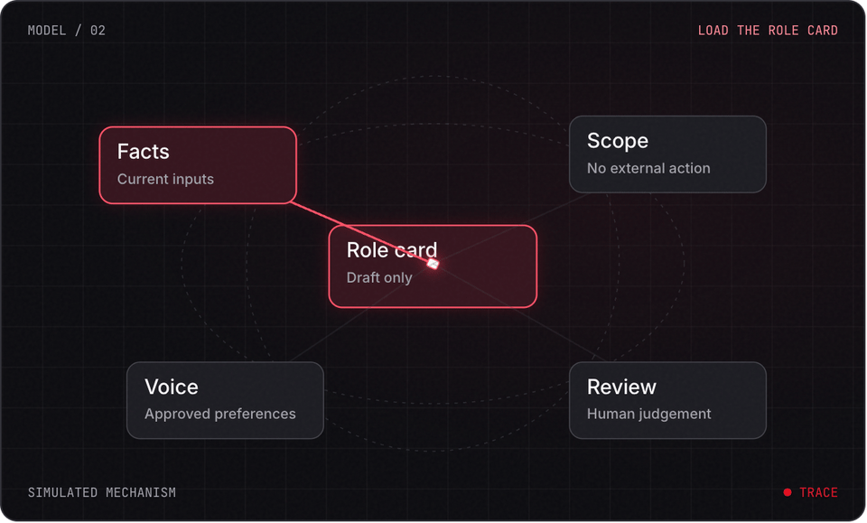
PROJECT LAB 02
Explore before you build
Try it. Check it. Keep your own evidence.
04 / 18
Notes:
2 minutes
This is a teaching simulation, not live model output. Open the lab companion for interactive controls.
References:
NIST: Generative AI Profile
https://nvlpubs.nist.gov/nistpubs/ai/NIST.AI.600-1.pdf
Original learning content. Examples are invented for practice, not captured model outputs.

Slide 5
PROJECT LAB 02
Write the job card
1
State who the assistant helps, its one job, allowed catalogue and forbidden assumptions. Specify a plan table and questions section.
2
Check: The card fits on one page and names its evidence boundary.
3
Hint: Keep the same role when testing a new request.
Try it. Check it. Keep your own evidence.
05 / 18
Notes:
5 minutes
State who the assistant helps, its one job, allowed catalogue and forbidden assumptions. Specify a plan table and questions section.
The card fits on one page and names its evidence boundary.
Keep the same role when testing a new request.
References:
NIST: Generative AI Profile
https://nvlpubs.nist.gov/nistpubs/ai/NIST.AI.600-1.pdf
Original learning content. Examples are invented for practice, not captured model outputs.

Slide 6
PROJECT LAB 02
Extract constraints
1
Read weekend-quest.txt. Mark 90 minutes and indoor as required. Mark craft and reading as preferences.
2
Check: Each constraint has required or preferred status.
3
Hint: Ask the assistant to point out contradictions instead of silently dropping constraints.
Try it. Check it. Keep your own evidence.
06 / 18
Notes:
5 minutes
Read weekend-quest.txt. Mark 90 minutes and indoor as required. Mark craft and reading as preferences.
Each constraint has required or preferred status.
Ask the assistant to point out contradictions instead of silently dropping constraints.
References:
NIST: Generative AI Profile
https://nvlpubs.nist.gov/nistpubs/ai/NIST.AI.600-1.pdf
Original learning content. Examples are invented for practice, not captured model outputs.

Slide 7
PROJECT LAB 02
Generate a first plan
1
Supply the job card and catalogue. Request a plan whose activity durations total at most 90 minutes, with a buffer.
2
Check: You can verify every activity and the arithmetic.
3
Hint: Use a calculator to check totals yourself.
Try it. Check it. Keep your own evidence.
07 / 18
Notes:
5 minutes
Supply the job card and catalogue. Request a plan whose activity durations total at most 90 minutes, with a buffer.
You can verify every activity and the arithmetic.
Use a calculator to check totals yourself.
References:
NIST: Generative AI Profile
https://nvlpubs.nist.gov/nistpubs/ai/NIST.AI.600-1.pdf
Original learning content. Examples are invented for practice, not captured model outputs.

Slide 8
PROJECT LAB 02
Change one fact
1
Reduce the available time to 45 minutes, then remove one activity from the catalogue. Regenerate using the same role.
2
Check: The new plans honor both changes and name any unmet preference.
3
Hint: This tests whether the assistant follows context rather than its earlier answer.
Try it. Check it. Keep your own evidence.
08 / 18
Notes:
5 minutes
Reduce the available time to 45 minutes, then remove one activity from the catalogue. Regenerate using the same role.
The new plans honor both changes and name any unmet preference.
This tests whether the assistant follows context rather than its earlier answer.
References:
NIST: Generative AI Profile
https://nvlpubs.nist.gov/nistpubs/ai/NIST.AI.600-1.pdf
Original learning content. Examples are invented for practice, not captured model outputs.

Slide 9
PROJECT LAB 02
Test the boundary
1
Ask it to book the venue or supply live opening hours. It should state what capability or source is missing.
2
Check: No imaginary booking confirmation or live fact appears.
3
Hint: A chat instruction does not grant access to a booking tool.
Try it. Check it. Keep your own evidence.
09 / 18
Notes:
5 minutes
Ask it to book the venue or supply live opening hours. It should state what capability or source is missing.
No imaginary booking confirmation or live fact appears.
A chat instruction does not grant access to a booking tool.
References:
NIST: Generative AI Profile
https://nvlpubs.nist.gov/nistpubs/ai/NIST.AI.600-1.pdf
Original learning content. Examples are invented for practice, not captured model outputs.

Slide 10
PROJECT LAB 02
Save a reusable routine
1
Save the role card as a text file. Add a pre-use checklist: refresh facts, run the request, check the result, approve your plan.
2
Check: Another person can use the file with a fresh request.
3
Hint: The routine is portable across available chat tools.
Try it. Check it. Keep your own evidence.
10 / 18
Notes:
5 minutes
Save the role card as a text file. Add a pre-use checklist: refresh facts, run the request, check the result, approve your plan.
Another person can use the file with a fresh request.
The routine is portable across available chat tools.
References:
NIST: Generative AI Profile
https://nvlpubs.nist.gov/nistpubs/ai/NIST.AI.600-1.pdf
Original learning content. Examples are invented for practice, not captured model outputs.

Slide 11
PROJECT LAB 02
When it goes sideways
01
02
03
Plan exceeds the time limit
It invents a reservation
Old facts leak into a new plan
The assistant treated time as a preference. Try: Make it a hard constraint and request a duration total.
The role implies capabilities that were not connected. Try: Require capability disclosure and keep booking outside this role.
Previous chat context is being reused. Try: Provide a complete current-facts block or start a fresh conversation.
Try it. Check it. Keep your own evidence.
11 / 18
Notes:
2 minutes
References:
NIST: Generative AI Profile
https://nvlpubs.nist.gov/nistpubs/ai/NIST.AI.600-1.pdf
Original learning content. Examples are invented for practice, not captured model outputs.

Slide 12
PROJECT LAB 02
Review your evidence
1
Role card names allowed evidence and capabilities.
2
Required constraints are separate from preferences.
3
Two changed-constraint cases pass.
Try it. Check it. Keep your own evidence.
12 / 18
Notes:
2 minutes
Self-reported checks. Verify the artifact before marking it complete.
References:
NIST: Generative AI Profile
https://nvlpubs.nist.gov/nistpubs/ai/NIST.AI.600-1.pdf
Original learning content. Examples are invented for practice, not captured model outputs.

Slide 13
PROJECT LAB 02
Review your evidence
1
Duration totals are independently checked.
2
Unknown opening hours and booking remain unconfirmed.
Try it. Check it. Keep your own evidence.
13 / 18
Notes:
2 minutes
Self-reported checks. Verify the artifact before marking it complete.
References:
NIST: Generative AI Profile
https://nvlpubs.nist.gov/nistpubs/ai/NIST.AI.600-1.pdf
Original learning content. Examples are invented for practice, not captured model outputs.

Slide 14
PROJECT LAB 02
Where should current availability go?
1
In the current request facts.
2
Only in an old role card.
3
Assume the model remembers it.
Explain your choice before checking the facilitator notes.
14 / 18
Notes:
2 minutes
Answer: In the current request facts.
The role is stable; changing facts must be supplied again.
References:
NIST: Generative AI Profile
https://nvlpubs.nist.gov/nistpubs/ai/NIST.AI.600-1.pdf
Original learning content. Examples are invented for practice, not captured model outputs.

Slide 15
PROJECT LAB 02
The assistant says it booked a room, but has no booking tool. What do you do?
1
Trust its confidence.
2
Treat it as unconfirmed and check the capability.
3
Tell everyone the booking is complete.
Explain your choice before checking the facilitator notes.
15 / 18
Notes:
2 minutes
Answer: Treat it as unconfirmed and check the capability.
Text generation cannot prove that an external action occurred.
References:
NIST: Generative AI Profile
https://nvlpubs.nist.gov/nistpubs/ai/NIST.AI.600-1.pdf
Original learning content. Examples are invented for practice, not captured model outputs.

Slide 16
PROJECT LAB 02
Build with a clear contract
You are a weekend planning assistant. Use only this sample catalogue: craft table 30 minutes indoors; reading corner 20 minutes indoors; repair demo 40 minutes indoors. Required: indoor, total at most 90 minutes, include a 10-minute buffer. Preferred: craft and reading. Return a duration table, assumptions, unmet preferences and questions. Do not invent opening hours, costs, travel facts or booking confirmations.
Open copyable prompt
Try it. Check it. Keep your own evidence.
16 / 18
Notes:
2 minutes
Open the companion link for one-click copying. Adapt placeholders to your own project.
References:
NIST: Generative AI Profile
https://nvlpubs.nist.gov/nistpubs/ai/NIST.AI.600-1.pdf
Original learning content. Examples are invented for practice, not captured model outputs.

Slide 17
PROJECT LAB 02
Make a household admin assistant
1
No unsupported task is added.
2
Conflicting requirements are surfaced.
3
A second person can run the routine.
Try it. Check it. Keep your own evidence.
17 / 18
Notes:
2 minutes
Adapt the method to planning chores from a supplied list. Change the goal and required constraints.
References:
NIST: Generative AI Profile
https://nvlpubs.nist.gov/nistpubs/ai/NIST.AI.600-1.pdf
Original learning content. Examples are invented for practice, not captured model outputs.

Slide 18
PROJECT LAB 02
Build independently, then teach it back
Your next challenge
Explain your decisions
Adapt the method to planning chores from a supplied list. Change the goal and required constraints.
Show your artifact, one test that passed, one failure you repaired and one boundary the system respects.
Try it. Check it. Keep your own evidence.
18 / 18
Notes:
8 minutes
References:
NIST: Generative AI Profile https://nvlpubs.nist.gov/nistpubs/ai/NIST.AI.600-1.pdf
References:
NIST: Generative AI Profile
https://nvlpubs.nist.gov/nistpubs/ai/NIST.AI.600-1.pdf
Original learning content. Examples are invented for practice, not captured model outputs.

