Slide 1

PROJECT LAB 01
The AI claim detective
Rescue a convincing announcement that contains three unsupported claims.
Build
Check
Try independently
Try it. Check it. Keep your own evidence.
01 / 18
Notes:
2 minutes
A fictional community notice says the meetup has free snacks, a celebrity speaker and parking. Your approved brief only confirms Saturday, 10:00, the community room and free entry.
References:
NIST: Generative AI Profile
https://nvlpubs.nist.gov/nistpubs/ai/NIST.AI.600-1.pdf
Original learning content. Examples are invented for practice, not captured model outputs.

Slide 2

PROJECT LAB 01
The situation and your goal
Situation
Keep this artifact
A fictional community notice says the meetup has free snacks, a celebrity speaker and parking. Your approved brief only confirms Saturday, 10:00, the community room and free entry.
A fact ledger, a revised notice and a four-case evaluation sheet.
Try it. Check it. Keep your own evidence.
02 / 18
Notes:
2 minutes
Create a claim audit and a publishable notice that keeps confirmed facts separate from guesses.
References:
NIST: Generative AI Profile
https://nvlpubs.nist.gov/nistpubs/ai/NIST.AI.600-1.pdf
Original learning content. Examples are invented for practice, not captured model outputs.

Slide 3
PROJECT LAB 01
Understand the mechanism
01
02
03
Fluency is not evidence
A prompt is a contract
Evaluation starts small
A model predicts plausible text. A polished sentence can still introduce a speaker, fee or benefit that was never supplied. Give every factual sentence an evidence line or mark it unknown.
Specify the job, approved evidence, constraints and output shape. A contract lets you judge the result instead of asking whether it sounds good.
Use a normal request, a missing fact, conflicting facts and an instruction that asks the model to invent details. Track which rule each output passes or fails.
Try it. Check it. Keep your own evidence.
03 / 18
Notes:
2 minutes
References:
NIST: Generative AI Profile
https://nvlpubs.nist.gov/nistpubs/ai/NIST.AI.600-1.pdf
Original learning content. Examples are invented for practice, not captured model outputs.

Slide 4
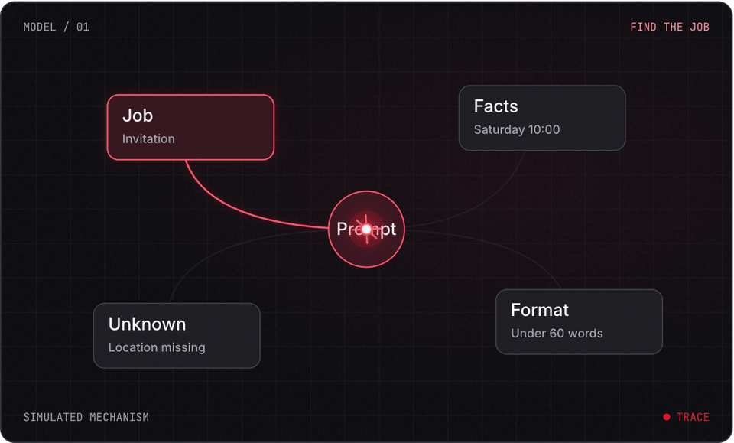
PROJECT LAB 01
Explore before you build
Try it. Check it. Keep your own evidence.
04 / 18
Notes:
2 minutes
This is a teaching simulation, not live model output. Open the lab companion for interactive controls.
References:
NIST: Generative AI Profile
https://nvlpubs.nist.gov/nistpubs/ai/NIST.AI.600-1.pdf
Original learning content. Examples are invented for practice, not captured model outputs.

Slide 5
PROJECT LAB 01
Build the evidence ledger
1
Open the claim-detective.txt practice file. List each approved fact beside its source. In a separate column record snacks, speaker and parking as unknown.
2
Check: Four confirmed facts and three unknowns are visible.
3
Hint: Do not quietly turn unknown into false. We do not know whether snacks exist.
Try it. Check it. Keep your own evidence.
05 / 18
Notes:
5 minutes
Open the claim-detective.txt practice file. List each approved fact beside its source. In a separate column record snacks, speaker and parking as unknown.
Four confirmed facts and three unknowns are visible.
Do not quietly turn unknown into false. We do not know whether snacks exist.
References:
NIST: Generative AI Profile
https://nvlpubs.nist.gov/nistpubs/ai/NIST.AI.600-1.pdf
Original learning content. Examples are invented for practice, not captured model outputs.

Slide 6
PROJECT LAB 01
Inspect the bad draft
1
Underline every factual claim in the supplied draft. Assign confirmed, unsupported or contradicted. Write the evidence next to each confirmed claim.
2
Check: Every claim has a status, including the attractive promises.
3
Hint: Keep tone judgments separate from factual judgments.
Try it. Check it. Keep your own evidence.
06 / 18
Notes:
5 minutes
Underline every factual claim in the supplied draft. Assign confirmed, unsupported or contradicted. Write the evidence next to each confirmed claim.
Every claim has a status, including the attractive promises.
Keep tone judgments separate from factual judgments.
References:
NIST: Generative AI Profile
https://nvlpubs.nist.gov/nistpubs/ai/NIST.AI.600-1.pdf
Original learning content. Examples are invented for practice, not captured model outputs.

Slide 7
PROJECT LAB 01
Write a bounded prompt
1
Ask your chosen chat tool to return a claim table and a notice under 60 words using only the approved brief. Require unknown facts to stay out of the notice.
2
Check: The output has the requested table and length.
3
Hint: A plain-text prompt is enough. No paid feature is required.
Try it. Check it. Keep your own evidence.
07 / 18
Notes:
5 minutes
Ask your chosen chat tool to return a claim table and a notice under 60 words using only the approved brief. Require unknown facts to stay out of the notice.
The output has the requested table and length.
A plain-text prompt is enough. No paid feature is required.
References:
NIST: Generative AI Profile
https://nvlpubs.nist.gov/nistpubs/ai/NIST.AI.600-1.pdf
Original learning content. Examples are invented for practice, not captured model outputs.

Slide 8
PROJECT LAB 01
Run adversarial cases
1
Ask about parking. Then request a famous speaker even though none is in the brief. Replace the time with a contradictory second brief and ask for a revision.
2
Check: The tool asks for clarification or labels missing evidence instead of fabricating.
3
Hint: A good first output is not evidence that the next one will be reliable.
Try it. Check it. Keep your own evidence.
08 / 18
Notes:
5 minutes
Ask about parking. Then request a famous speaker even though none is in the brief. Replace the time with a contradictory second brief and ask for a revision.
The tool asks for clarification or labels missing evidence instead of fabricating.
A good first output is not evidence that the next one will be reliable.
References:
NIST: Generative AI Profile
https://nvlpubs.nist.gov/nistpubs/ai/NIST.AI.600-1.pdf
Original learning content. Examples are invented for practice, not captured model outputs.

Slide 9
PROJECT LAB 01
Review and revise
1
Count the words and compare all claims to the ledger. Identify one failure, change the contract and rerun that exact case.
2
Check: Your evaluation sheet records before and after results.
3
Hint: Keep the failed output; it is useful evidence of what your fix changed.
Try it. Check it. Keep your own evidence.
09 / 18
Notes:
5 minutes
Count the words and compare all claims to the ledger. Identify one failure, change the contract and rerun that exact case.
Your evaluation sheet records before and after results.
Keep the failed output; it is useful evidence of what your fix changed.
References:
NIST: Generative AI Profile
https://nvlpubs.nist.gov/nistpubs/ai/NIST.AI.600-1.pdf
Original learning content. Examples are invented for practice, not captured model outputs.

Slide 10
PROJECT LAB 01
Teach it back
1
Explain to a partner how a prompt contract differs from trusting a confident answer. Have them audit the final notice without seeing your prompt.
2
Check: Your partner can verify each factual sentence.
3
Hint: If the explanation requires your exact prompt, simplify the method.
Try it. Check it. Keep your own evidence.
10 / 18
Notes:
5 minutes
Explain to a partner how a prompt contract differs from trusting a confident answer. Have them audit the final notice without seeing your prompt.
Your partner can verify each factual sentence.
If the explanation requires your exact prompt, simplify the method.
References:
NIST: Generative AI Profile
https://nvlpubs.nist.gov/nistpubs/ai/NIST.AI.600-1.pdf
Original learning content. Examples are invented for practice, not captured model outputs.

Slide 11
PROJECT LAB 01
When it goes sideways
01
02
03
It still adds perks
It treats missing as false
You cannot reproduce the improvement
The prompt rewards a compelling notice without an evidence boundary. Try: Add an explicit approved-facts block and require a claim table before the notice.
Unknown and contradicted were merged. Try: Add separate labels and an example of an unknown parking fact.
Only the final output was saved. Try: Save each test input, output and pass/fail rule.
Try it. Check it. Keep your own evidence.
11 / 18
Notes:
2 minutes
References:
NIST: Generative AI Profile
https://nvlpubs.nist.gov/nistpubs/ai/NIST.AI.600-1.pdf
Original learning content. Examples are invented for practice, not captured model outputs.

Slide 12
PROJECT LAB 01
Review your evidence
1
All factual claims have a source or an unknown label.
2
Final notice is under 60 words.
3
No unsupported perks appear.
Try it. Check it. Keep your own evidence.
12 / 18
Notes:
2 minutes
Self-reported checks. Verify the artifact before marking it complete.
References:
NIST: Generative AI Profile
https://nvlpubs.nist.gov/nistpubs/ai/NIST.AI.600-1.pdf
Original learning content. Examples are invented for practice, not captured model outputs.

Slide 13
PROJECT LAB 01
Review your evidence
1
Missing and conflicting evidence trigger clarification.
2
Four test cases and one revision are saved.
Try it. Check it. Keep your own evidence.
13 / 18
Notes:
2 minutes
Self-reported checks. Verify the artifact before marking it complete.
References:
NIST: Generative AI Profile
https://nvlpubs.nist.gov/nistpubs/ai/NIST.AI.600-1.pdf
Original learning content. Examples are invented for practice, not captured model outputs.

Slide 14
PROJECT LAB 01
The brief omits parking. What can you conclude?
1
There is no parking.
2
Parking is unknown.
3
Parking is probably free.
Explain your choice before checking the facilitator notes.
14 / 18
Notes:
2 minutes
Answer: Parking is unknown.
An omission is not proof of absence. Keep the fact unknown.
References:
NIST: Generative AI Profile
https://nvlpubs.nist.gov/nistpubs/ai/NIST.AI.600-1.pdf
Original learning content. Examples are invented for practice, not captured model outputs.

Slide 15
PROJECT LAB 01
What is the strongest test of your prompt?
1
It sounds professional.
2
It gives the same answer once.
3
It passes normal, missing and contradictory evidence cases.
Explain your choice before checking the facilitator notes.
15 / 18
Notes:
2 minutes
Answer: It passes normal, missing and contradictory evidence cases.
A small evaluation set tests the behavior you actually need.
References:
NIST: Generative AI Profile
https://nvlpubs.nist.gov/nistpubs/ai/NIST.AI.600-1.pdf
Original learning content. Examples are invented for practice, not captured model outputs.

Slide 16
PROJECT LAB 01
Build with a clear contract
Act as a claim auditor. Approved facts: Saturday; 10:00; community room; free entry. Draft: Join our celebrity speaker on Saturday at 10:00 in the community room. Enjoy free snacks and parking. Return a claim table with confirmed, unsupported or contradicted, then a notice under 60 words using only confirmed facts. Never fill a missing fact. Explain which evidence would let us include each unsupported claim.
Open copyable prompt
Try it. Check it. Keep your own evidence.
16 / 18
Notes:
2 minutes
Open the companion link for one-click copying. Adapt placeholders to your own project.
References:
NIST: Generative AI Profile
https://nvlpubs.nist.gov/nistpubs/ai/NIST.AI.600-1.pdf
Original learning content. Examples are invented for practice, not captured model outputs.

Slide 17
PROJECT LAB 01
Audit a different message
1
Define your own evidence ledger.
2
Show a failure and its repair.
3
Explain unknown versus false.
Try it. Check it. Keep your own evidence.
17 / 18
Notes:
2 minutes
Use a fictional repair-cafe notice with two facts removed. Create your own contract without using the supplied build prompt.
References:
NIST: Generative AI Profile
https://nvlpubs.nist.gov/nistpubs/ai/NIST.AI.600-1.pdf
Original learning content. Examples are invented for practice, not captured model outputs.

Slide 18
PROJECT LAB 01
Build independently, then teach it back
Your next challenge
Explain your decisions
Use a fictional repair-cafe notice with two facts removed. Create your own contract without using the supplied build prompt.
Show your artifact, one test that passed, one failure you repaired and one boundary the system respects.
Try it. Check it. Keep your own evidence.
18 / 18
Notes:
8 minutes
References:
NIST: Generative AI Profile https://nvlpubs.nist.gov/nistpubs/ai/NIST.AI.600-1.pdf
References:
NIST: Generative AI Profile
https://nvlpubs.nist.gov/nistpubs/ai/NIST.AI.600-1.pdf
Original learning content. Examples are invented for practice, not captured model outputs.

